Slide 1
Home Modification Tax Credit Program 7-15-19

Slide 2
Home Mod Tax Credit
HB18-12-67 allows Coloradans to claim a state income tax credit for up to $5,000 of qualified costs incurred while retrofitting their residence for the purpose of improving accessibility, increasing visitability, or for allowing individuals to age in place.
The credit is available for tax years 2019 through 2023.
This is not a Medicaid or Division of Housing funded program or a grant or loan program – it is a credit you can take against your state income taxes.

Slide 3
Who Can Qualify?
The individual applying for the tax credit must:
Be a state income taxpayer with a disability, illness or impairment
OR have a spouse/dependent with a disability, illness or impairment (effective August 2, 2019)
Occupy the residence being modified and
Have an annual family income at or below $150,000.
Renters as well as homeowners can apply for the tax credit.

Slide 4
Eligible Residence
•The residence being modified must exist before the work begins – the work may not be completed during initial construction of the residence.
•The residence must be currently occupied as the home of the qualified individual and the person for whom the retrofit is required.
•The residence must be located in Colorado.

Slide 5
Eligible Modifications
•Be necessary to ensure the health, welfare, and safety of the qualified individual and/or their dependent(s);
•Increase the residence’s visitability and allow the qualified individual and/or their dependent(s) to age in place;
•Be required due the qualified individual’s and/or their dependent(s) illness, impairment or disability;
•Meet the Division of Housing's Home Modification Construction Specifications; and
•Be completed in the tax year for which the qualified individual will receive the tax credit.

Slide 6
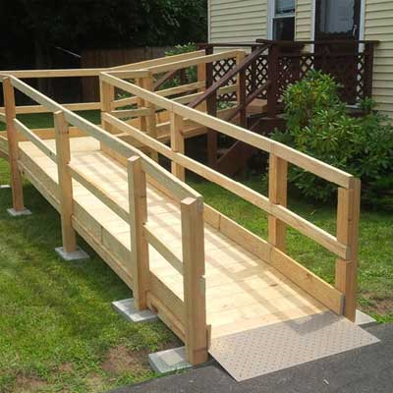
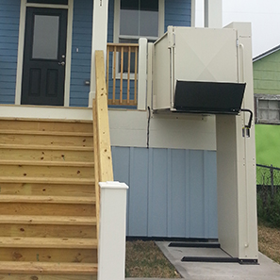
Examples of Eligible Modifications
Accessible Entrances
Ramps
Wood
Metal
Concrete
Wheelchair Lifts

Slide 7
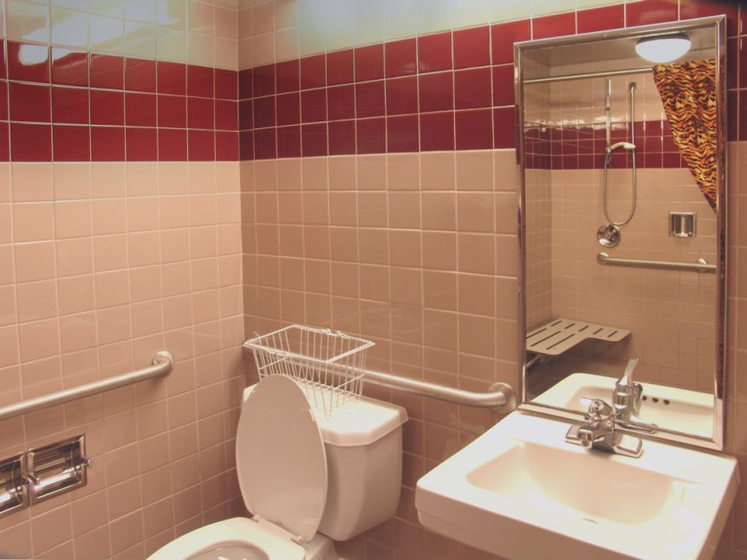
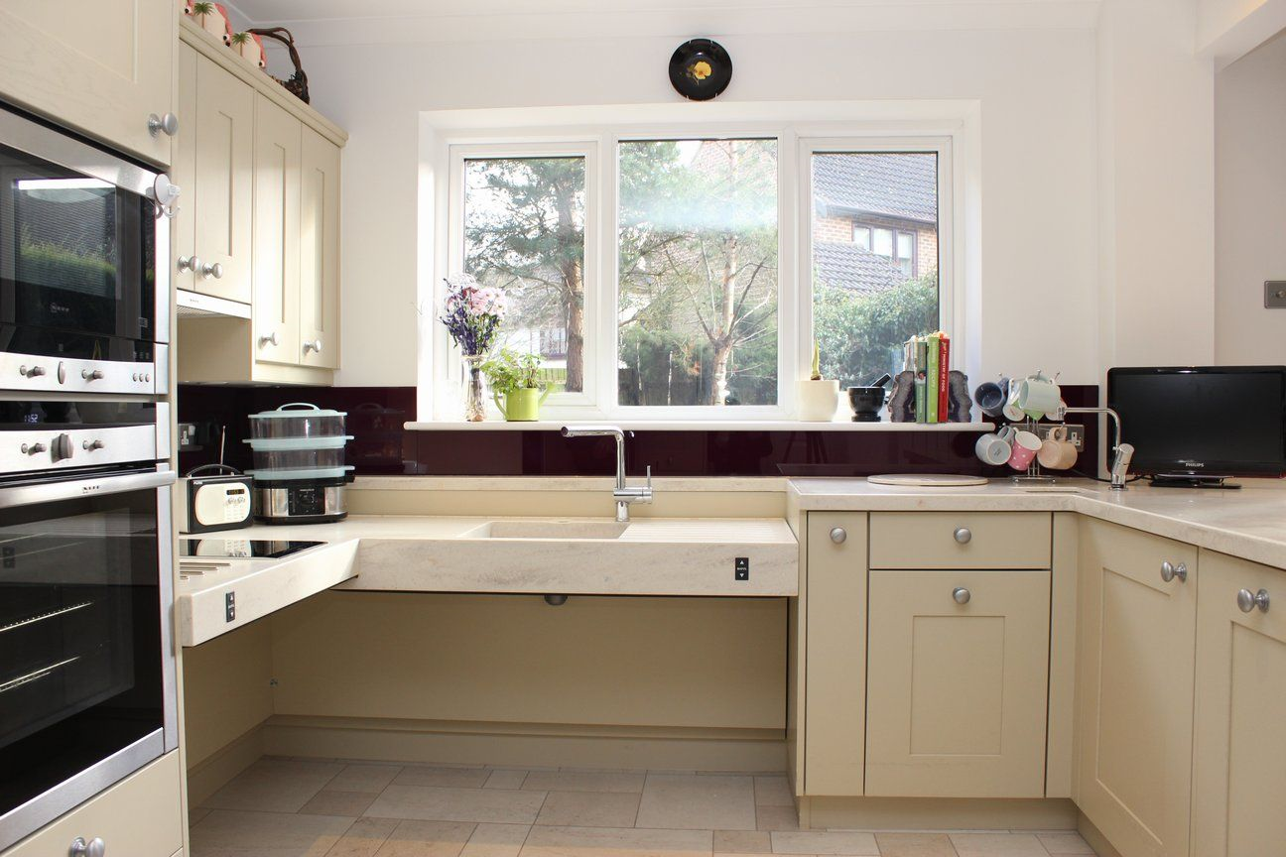
Examples of Eligible Modifications
Accessible Bathrooms
Accessible Kitchens

Slide 8
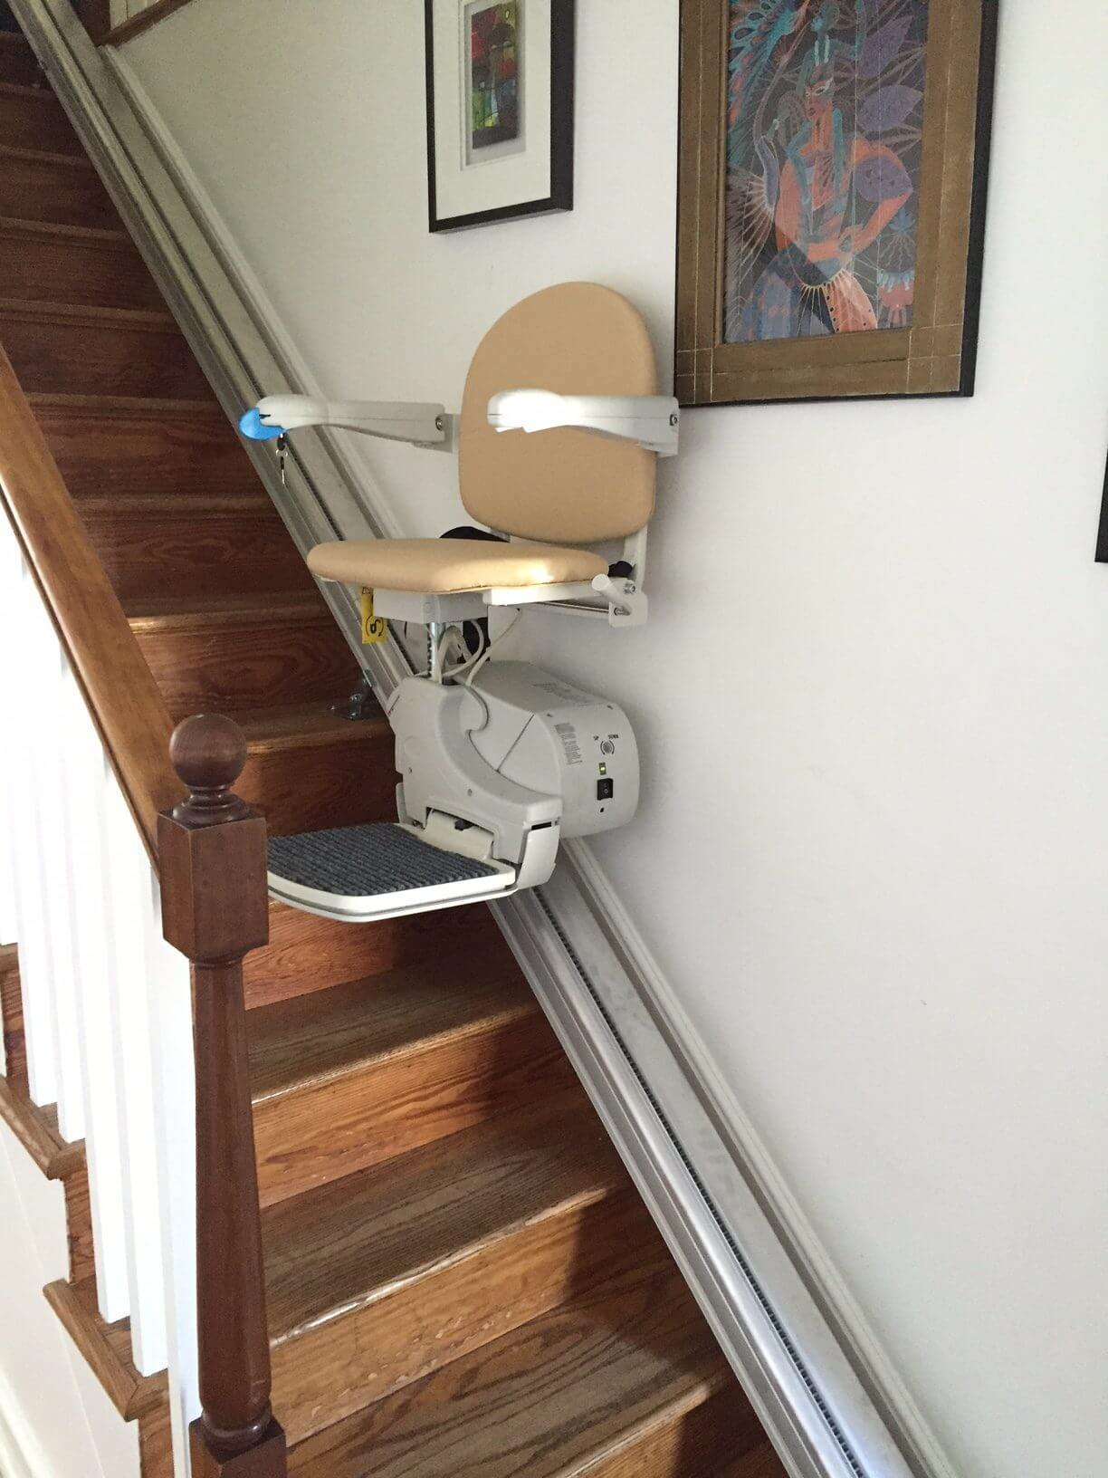
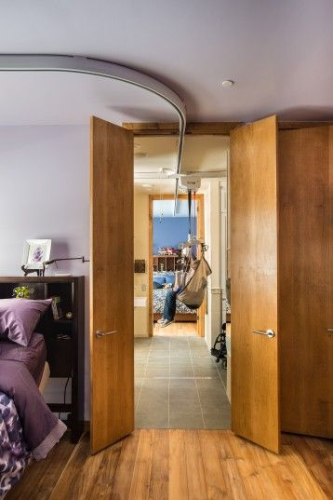
Examples of Eligible Modifications
Interior Stair Glide
Ceiling Track System

Slide 9
Examples of Eligible Modifications

Slide 10
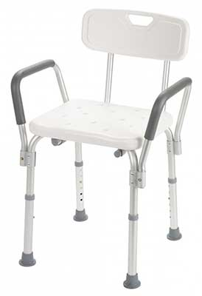
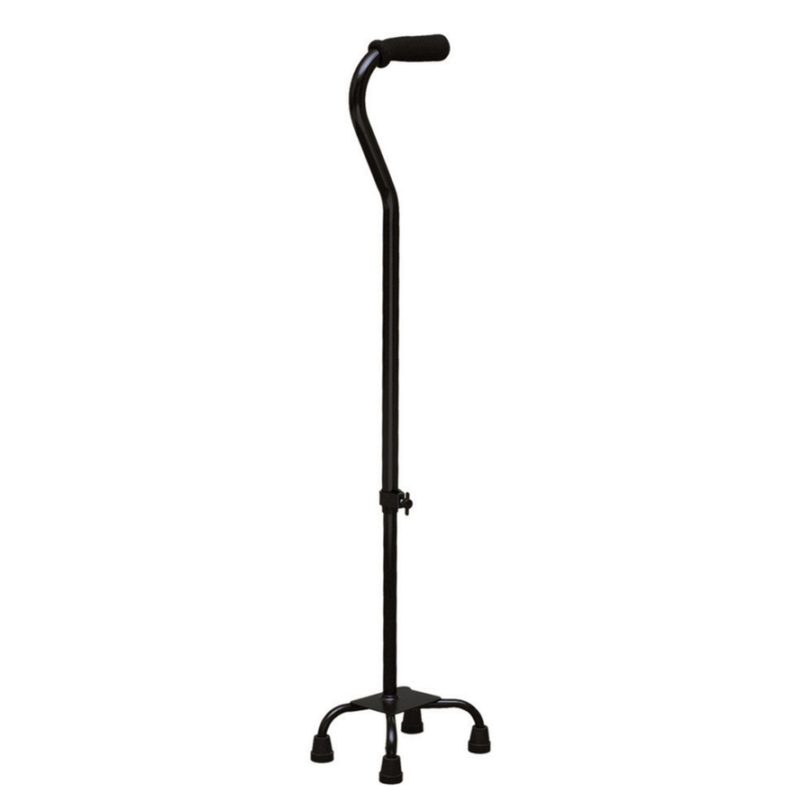
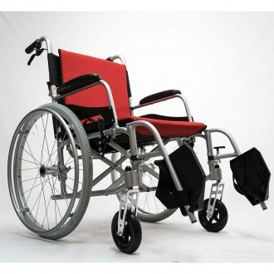
Please note, durable medical equipment and other items that are not installed or affixed to the residence are not eligible modifications.

Slide 11
How to Apply Online
DOLA/DOH Website:
https://www.colorado.gov/pacific/dola/home-modification-tax-credit
hometaxcredit.colorado.gov
Complete the Pre-Qualification Survey to see if you qualify
Complete the Initial Application to see if the work you’re proposing qualifies
Complete the Final Application to document that the work is complete & get your tax credit certificate

Slide 12
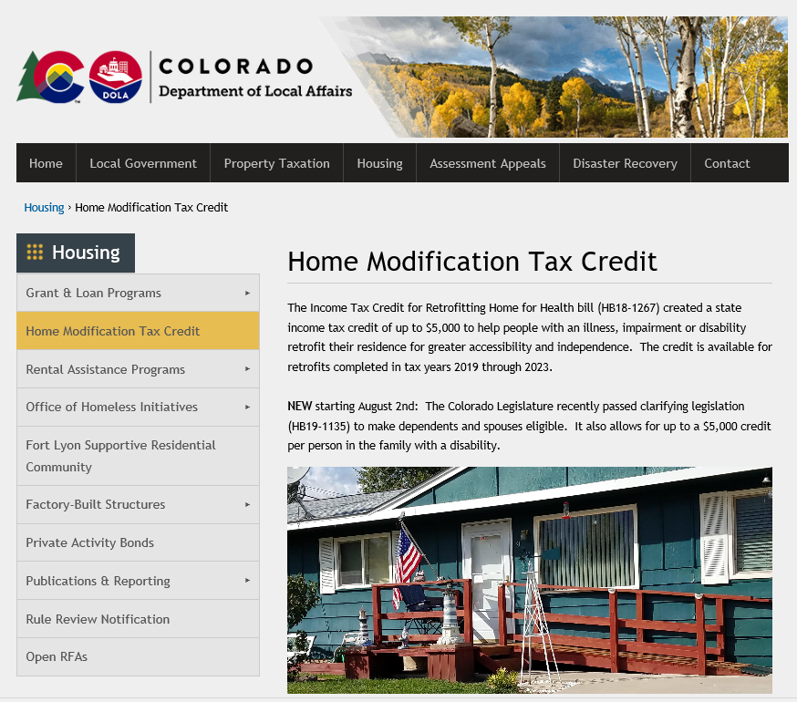

Slide 13
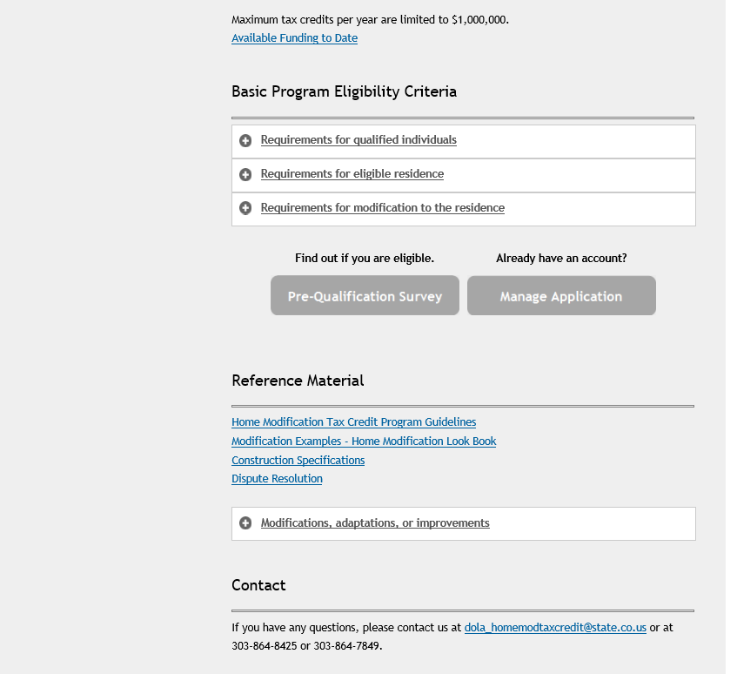

Slide 14
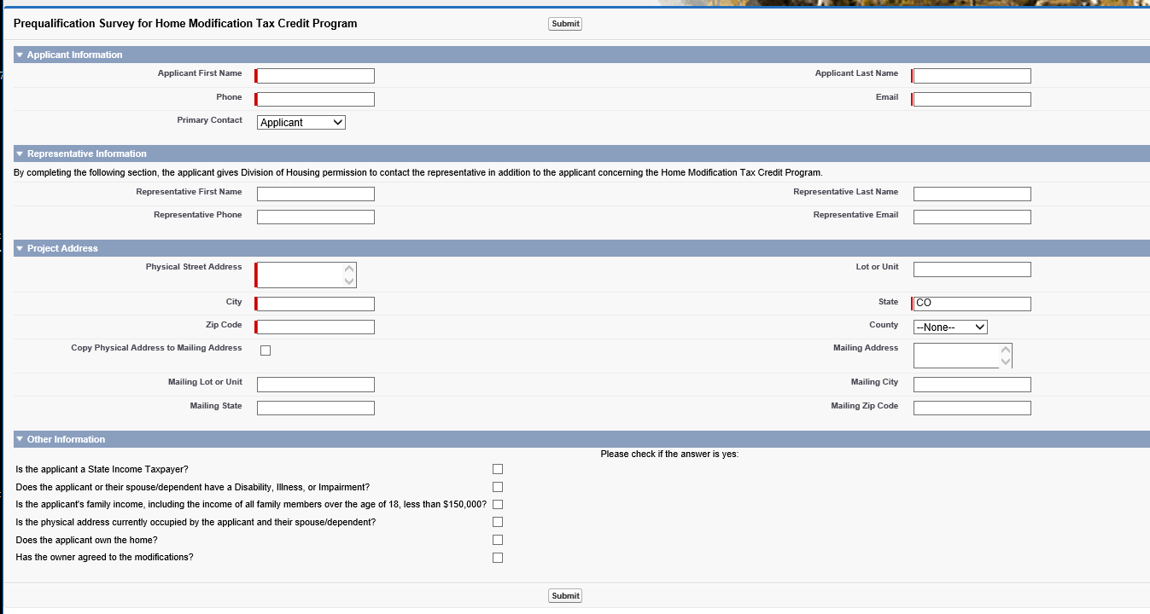

Slide 15
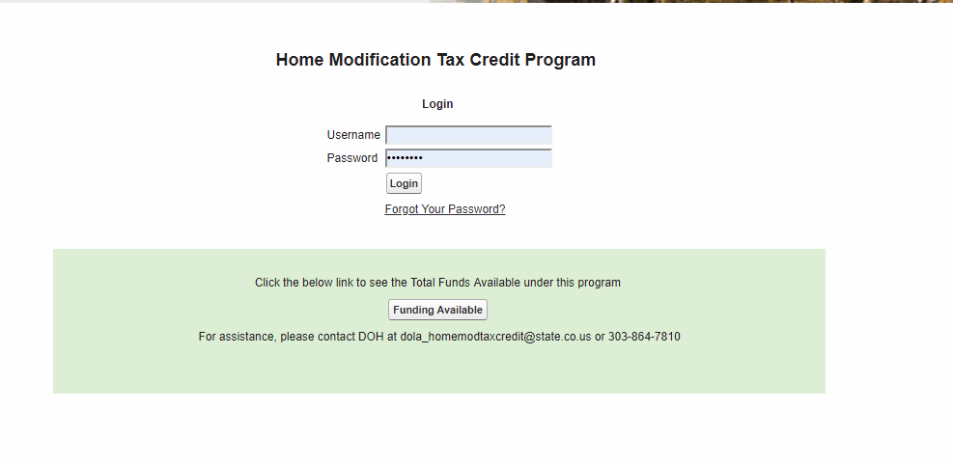
After the applicant is determined to be eligible based on the Pre-Qual Survey, they are able to create an account. They – or their Representative - can log into their account at any time to view the status of their application, edit their application, upload information, etc.

Slide 16
We recommend that you have all documents ready to upload when you start the Initial Application, although you can save it and return to it later if needed.

Slide 17
Scroll down to this section to add information about family members
Upload documents in the FILES section

Slide 18
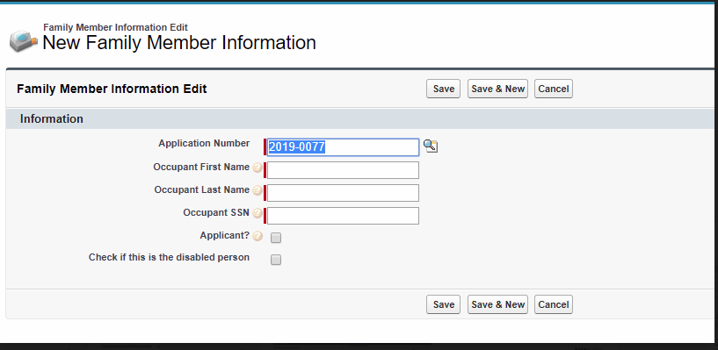

Slide 20
Review/Approval Process
At each step in the process, DOH staff will review the information provided.
DOH will contact the applicant/representative if we need additional information.
When the Final Application is approved, the applicant will receive the Tax Credit Certificate. The certificate will need to be attached to their state income return.
Questions? Please contact Anthony Page
Anthony.page@state.co.us
303-864-7864

Slide 21
Questions? Please contact
Anthony Page
Anthony.page@state.co.us
303-864-7864

