Slide 1

State of the States in Intellectual and Developmental Disabilities 2017
Shea Tanis, Ph.D.
Associate Director
Coleman Institute for Cognitive Disabilities
June 22, 2017
2017 Alliance Summit

Slide 2
Presentation Overview
Highlights of Financial and Programmatic Trends FY 2015
Colorado Services and Supports
Threat to Medicaid

Slide 3

Project of National Significance: Longitudinal Data Collection Projects
Ongoing Data Collection and Information Dissemination Projects
  The State of the States in Intellectual and Developmental Disabilities, University of Colorado
  Access to Integrated Employment: National Data Collection on Day and Employment Services for Citizens with Developmental Disabilities, University of Massachusetts Boston
  The National Residential Information Systems Project (RISP), University of Minnesota

Slide 4

Highlights
Financial and Programmatic Trends in Supports and Services for People with IDD Updated FY 2015
11th Edition (In Press)
Published by American Association on Intellectual and Developmental Disabilities

Slide 5
Key Federal and State Financial Supports Utilized in Data Collection
I. INSTITUTIONAL SERVICES FINANCIAL DATA
(16 or more persons)
A. Public 16+ Institutional Services Funds
1. State Funds
  a. ICF/ID Medicaid Match
  b. General Funds (not including state ICF/MR match)
  c. Other State Funds (not including state ICF/MR match)
  d. Local Funds in Excess of Match
2. Federal Funds
  a. Federal ICF/ID
  b. Title XX/Social Services Block Grant
  c. Other Federal Funds
B. Private 16+ Institutional Services Funds
1. State Funds
  a. ICF/ID Medicaid Match
  b. General Funds (not including state ICF/ID match)
  c. Other State Funds (not including state ICF/ID match)
  d. Local Funds in Excess of Match
2. Federal Funds
  a. Federal ICF/ID
  b. Other Federal Funds
II. COMMUNITY SERVICES FINANCIAL DATA
(15 or fewer persons)
A. Community Services Funds for 15 or Fewer Persons
1. State Funds
  a. ICF/ID Medicaid Match
  b. General Funds (not including state ICF/ID match)
  c. Other State Funds (not including state ICF/ID match)
  d. Local/County Funds in Excess of Match
  e. SSI State Supplement Funds
2. Federal Funds
  a. Public ICF/ID (<16)
  b. Private ICF/ID (<16)
  c. HCBS Waiver
  d. Other Medicaid Services
  1. Rehabilitation Services
  2. Clinic Services
  3. Targeted Case Management
  4. Personal Care Services
  5. Other Medicaid Services
  e. Title XX/Social Services Block Grant
  f. Other Federal Funds
  g. SSI and Adults Disabled in Childhood (ADC) benefits –
  HCBS Waiver participants
  Sources: Braddock (1981, 2002a); Braddock, Hemp, & Fujiura (1987).

Slide 6
Key Program and Participant Categories

Slide 7

Don’t Drown in the Data

Slide 8

Total Public Disability Spending: U.S. 2013
Source: Braddock, D., Hemp, R., Tanis, E.S., et al.(2017).The State of the States in Intellectual Disabilities:2017
Notes:
Income maintenance – supplemental security income, ssi state supplement, SSDI, adult disabled child (ADC) veterans compensation food stamps, HUD
Health care – Medicare, Medicaid, Veterans Medical care
LTC – Community (IDD state programs, Mental illness state agency programs, HCBS waiver, Medicaid home health care, Medicaid personal care, VR, independent living, Veteran rehabilitation, HUD construction

Slide 9
Total IDD Spending In the U.S. FYs 1977 - 2015
2013 - 2015 IDD Spending Grew 2%
Source: Braddock, D., Hemp, R., Tanis, E.S., et al.(2017).The State of the States in Intellectual Disabilities:2017
Notes:
IDD spending fell 1% in FY 2011; Rebounds in FY 2012-2015 in the U.S.

Slide 10
Annual Percent Change in Total Inflation-Adjusted IDD Spending in the U.S.
Source: Braddock, D., Hemp, R., Tanis, E.S., et al.(2017).The State of the States in Intellectual Disabilities:2017
Notes:
For the first time in 39 years of data collection IDD spending dropped

Slide 11
Percent Change in State IDD Spending from 2013-2015
Source: Braddock, D., Hemp, R., Tanis, E.S., et al.(2017).The State of the States in Intellectual Disabilities:2017
Notes:
9 states reduced inflation adjusted IDD spending

Slide 12
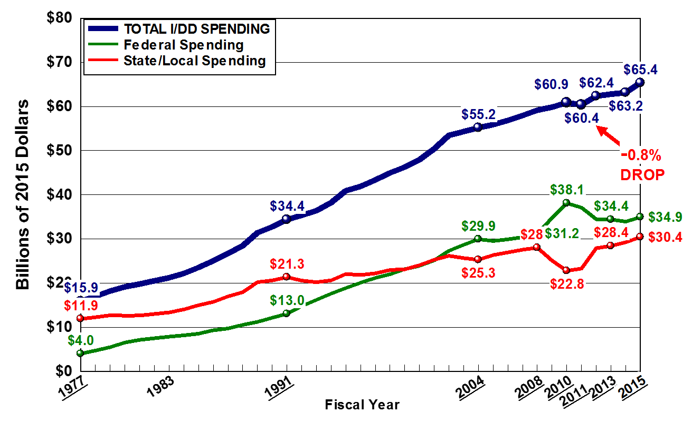
Federal and State/Local Spending in the U.S.
Source: Braddock, D., Hemp, R., Tanis, E.S., et al.(2017).The State of the States in Intellectual Disabilities:2017

Slide 13

Fiscal Effort
Fiscal Effort is a measure of how much a state spends on IDD LTSS per $1,000 of statewide personal income.
…in other words, how much does your state spend after you control for state wealth – this allows you to compare your state to any other state regardless of state wealth.
U.S. Total Fiscal Effort: $4.30
CO Total Fiscal Effort: $2.29 ↑ 4%
  Ranks 47th
U.S. Community Fiscal Effort: $3.81
CO Community Fiscal Effort: $2.14
  Ranks 45th
Source: Braddock, D., Hemp, R., Tanis, E.S., et al.(2017).The State of the States in Intellectual Disabilities:2017

Slide 14
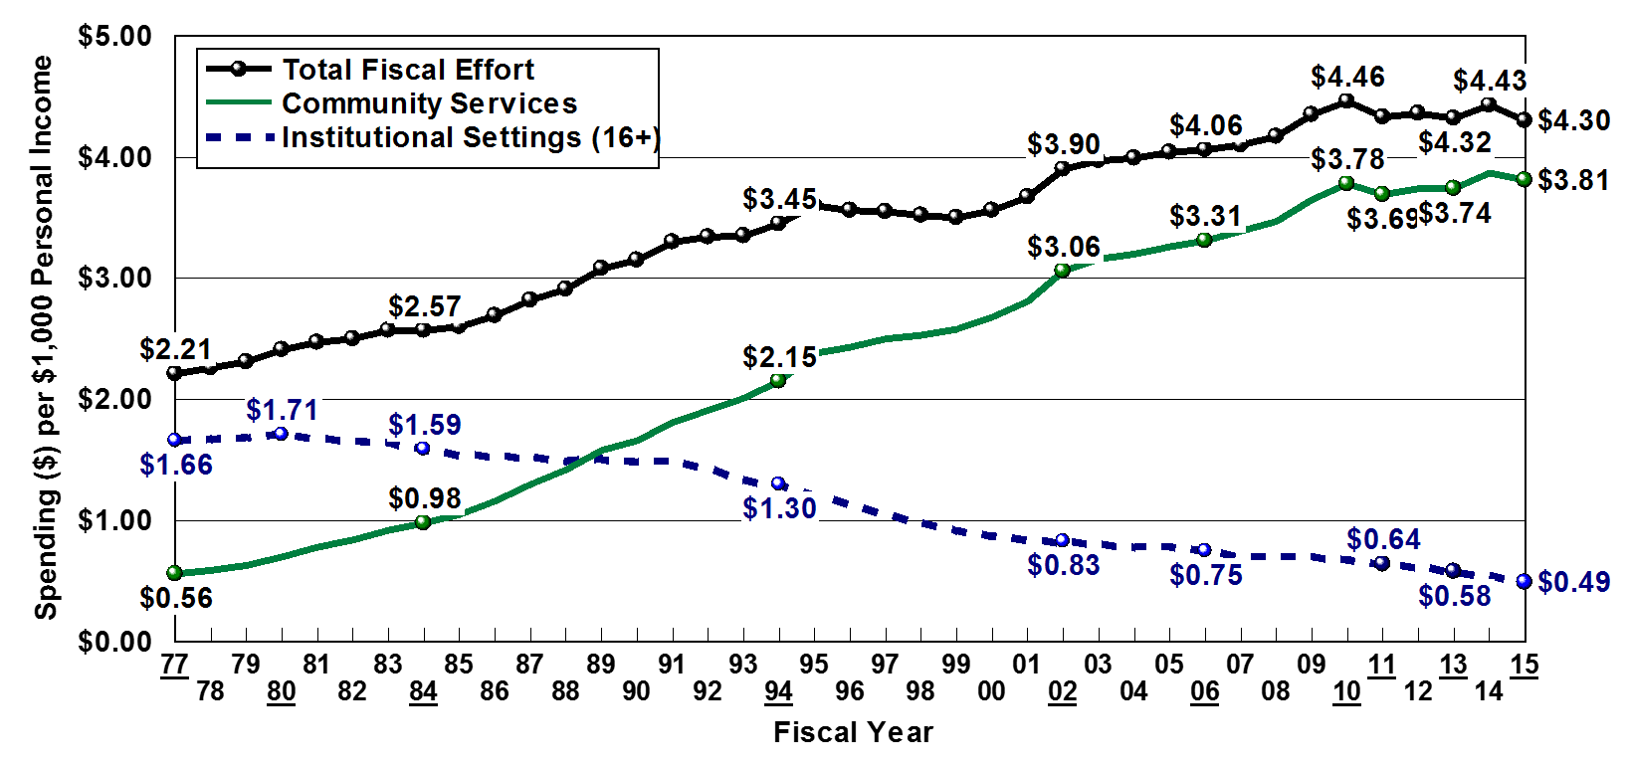
Total Fiscal Effort for IDD Services in the U.S.
Source: Braddock, D., Hemp, R., Tanis, E.S., et al.(2017).The State of the States in Intellectual Disabilities:2017

Slide 15
Community Services Fiscal Effort in the U.S. FY 2015
UNITED STATES: $3.81
Source: Braddock, D., Hemp, R., Tanis, E.S., et al.(2017).The State of the States in Intellectual Disabilities:2017
Notes:
Fiscal Effort Varies Over 500% In the States

Slide 16
Where a Person Lives
“Self-advocacy groups…have clear positions on residential services…smaller, community, person-centered…settings that promote community living and participation.
- Joint Paper AAIDD & AUCD Community Living and Participation for People with Intellectual and Developmental Disabilities: What the Research Tells Us (2015)

Slide 17
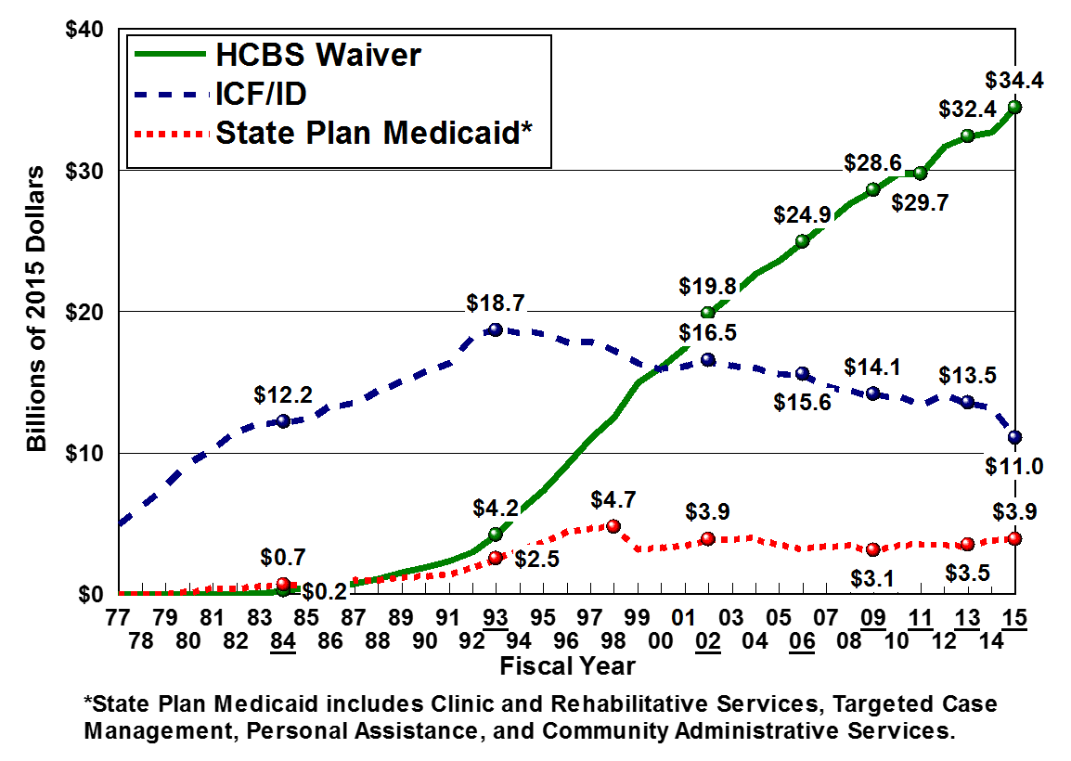
ICF/ID Spending Dropped 19% FY 2013-2015
-19%
Source: Braddock, D., Hemp, R., Tanis, E.S., et al.(2017).The State of the States in Intellectual Disabilities:2017
Notes:
Dropped 19%

Slide 18
Out-of-Home Placements
Source: Braddock, D., Hemp, R., Tanis, E.S., et al.(2017).The State of the States in Intellectual Disabilities:2017
Notes:
Utilization Rate: 212 per 100,000

Slide 19
Increased Demand for Six or Fewer Residential Services
Source: Braddock, D., Hemp, R., Tanis, E.S., et al.(2017).The State of the States in Intellectual Disabilities:2017

Slide 20

Institutionalization
SABE, in their 1995 statement about institutions, said “We believe that all institutions, both private and public should be closed. All people regardless of severity of their disabilities should live in the community with the support they need.”
14 states have closed all institutions: DC, NH, VT, RI, AK, NM, WV, HI, ME, IN, MI, OR, MN, and AL
D. Braddock, University of Colorado, 2007.
Source: Braddock, D., Hemp, R., Tanis, E.S., et al.(2017).The State of the States in Intellectual Disabilities:2017

Slide 21
Institutional Residents with IDD in the U.S.
HCBS Waiver, 1981
Source: Braddock, D., Hemp, R., Tanis, E.S., et al.(2017).The State of the States in Intellectual Disabilities:2017
Notes:
Excludes nursing facilities (27,306 in 2015)
1981 Waiver services

Slide 22
133 State-Operated Remain in 2015
Wheat Ridge (112 persons)
Grand Junction (36 persons))
Source: Braddock, D., Hemp, R., Tanis, E.S., et al.(2017).The State of the States in Intellectual Disabilities:2017

Slide 23
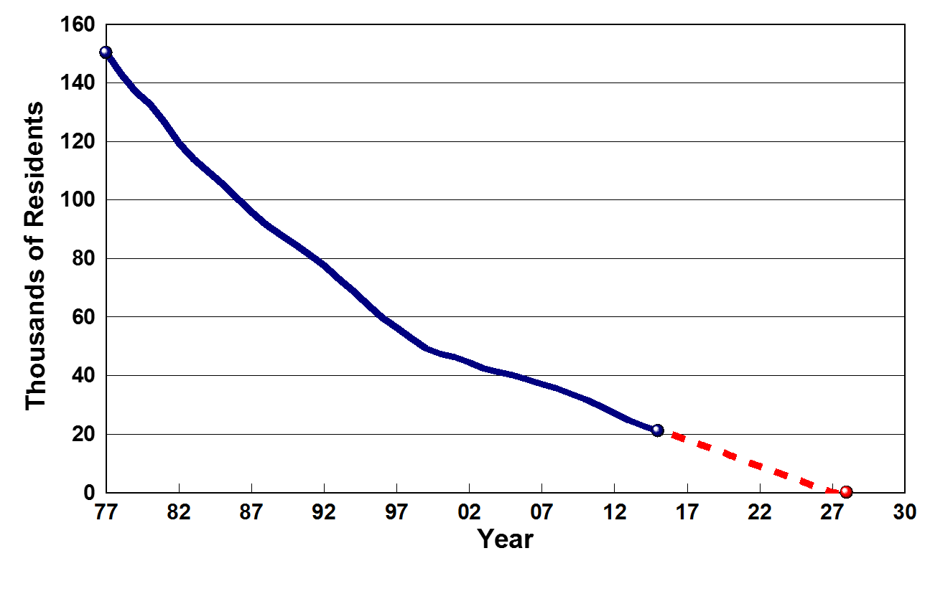

Projected Closure of State-Operated Institutions
Source: Braddock, D., Hemp, R., Tanis, E.S., et al.(2017).The State of the States in Intellectual Disabilities:2017
Notes:
Not by 2028 if current trends continue

Slide 24
Who’s Next?
Source: Braddock, D., Hemp, R., Tanis, E.S., et al.(2017).The State of the States in Intellectual Disabilities:2017

Slide 25

Home and Community-Based Services Waiver
HCBS waivers “waive” certain Medicaid requirements applied to Medicaid nursing or other facilities, thereby making Medicaid funding eligible to those living in home-like and family settings.

Slide 26
HCBS Waiver Participants with IDD in the U.S.
30% Growth 2009-2015
Source: Braddock, D., Hemp, R., Tanis, E.S., et al.(2017).The State of the States in Intellectual Disabilities:2017

Slide 27
Federal-State-Local Medicaid Provided 76% of Total IDD Spending
Source: Braddock, D., Hemp, R., Tanis, E.S., et al.(2017).The State of the States in Intellectual Disabilities:2017

Slide 28
Individual and Family Support Spending On the Rise
Source: Braddock, D., Hemp, R., Tanis, E.S., et al.(2017).The State of the States in Intellectual Disabilities:2017

Slide 29
People with IDD Living with Family Caregivers

Slide 30
State IDD Agencies Supported Only 17% of Caregiving Families
Source: Braddock, D., Hemp, R., Tanis, E.S., et al.(2017).The State of the States in Intellectual Disabilities:2017

Slide 31
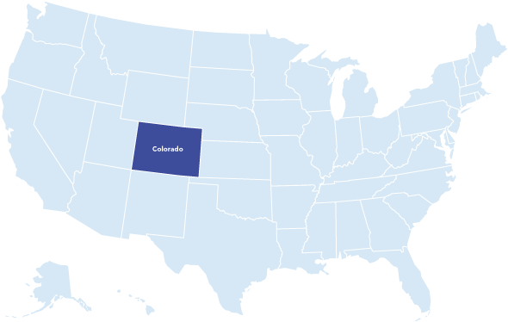

Colorado Services and Supports

Slide 32
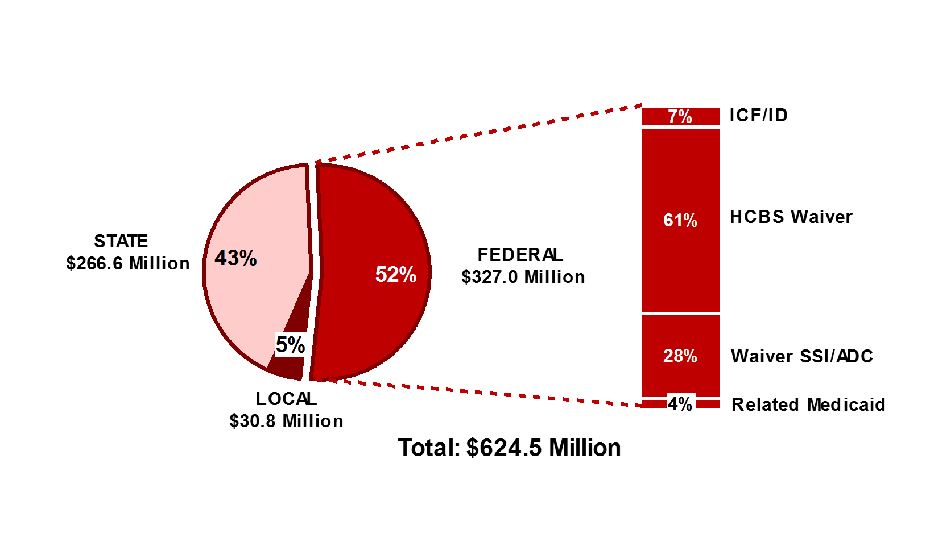
Total Public IDD Spending By Revenue Source in Colorado
Source: Braddock, D., Hemp, R., Tanis, E.S., et al.(2017).The State of the States in Intellectual Disabilities:2017
Notes:
U.S.
State $28.79 Billion (44%)
Local $1.47 Billion (2%)
Federal $34.95 Billion (54%)
HCBS Waiver 56%
Waiver SSI/ADC 18%
ICF/ID 18%
Related Medicaid 6%

Slide 33
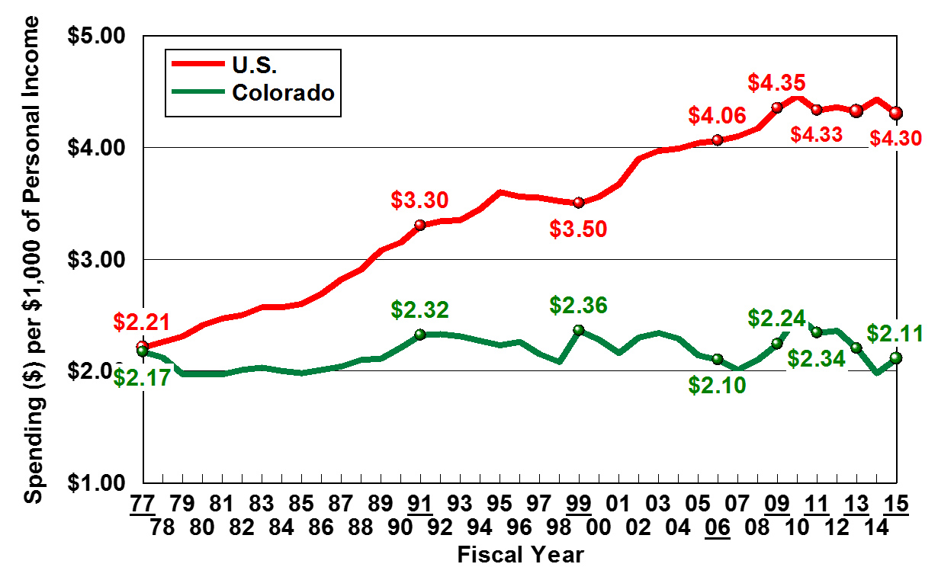

Colorado’s Fiscal Effort for IDD Services is Over 50% Below the National Average
TABOR
Source: The State of the States in Intellectual Disabilities Project:2017
Notes:
1992 Tabor (Taxpayers Bill of Rights) constitutional amendment
It is the most restrictive tax and spending limitation in the country!
TABOR limited the amount of revenue governments could collect and spend. Taxpayers received TABOR refunds on their state income taxes, and mill levies were suppressed to prevent governments from collecting too much in property tax.
Re-evaluation of Tabor begani in 2015 is still being addressed

Slide 34
Fiscal Effort for IDD Services in Colorado
Source: Braddock, D., Hemp, R., Tanis, E.S., et al.(2017).The State of the States in Intellectual Disabilities:2017

Slide 35
Total Fiscal Effort in Comparison States
Source: The State of the States in Intellectual Disabilities Project:2017

Slide 36
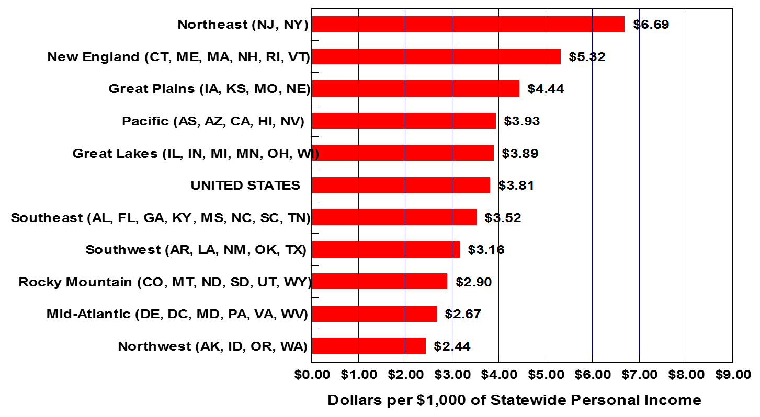
Colorado Lagged All 10 U.S. Regions in Community Services Fiscal Effort in FY 2015
COLORADO: $2.14
Source: The State of the States in Intellectual Disabilities Project:2017

Slide 37
Colorado IDD Spending by Service Category: FY 2015
Source: Braddock, D., Hemp, R., Tanis, E.S., et al.(2017).The State of the States in Intellectual Disabilities:2017

Slide 38
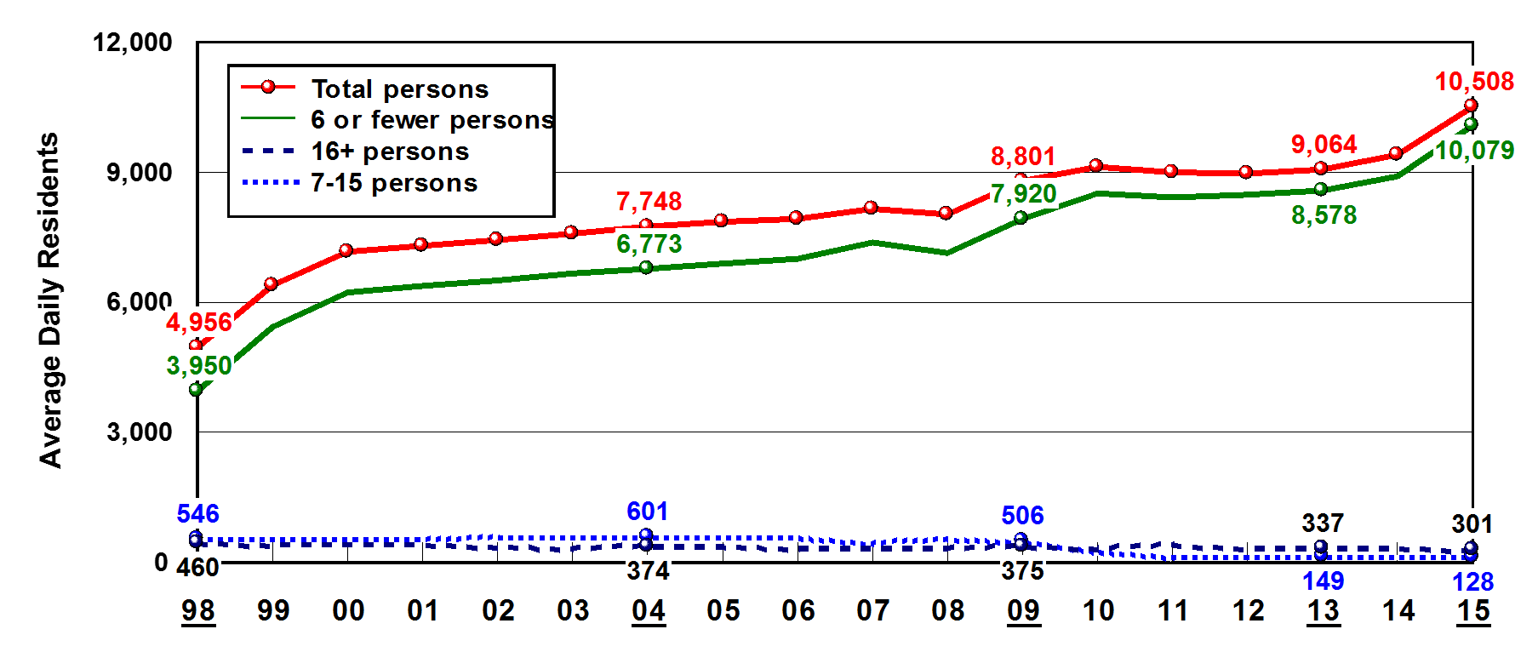
Number of Residents by Size of Setting in Colorado
Source: Braddock, D., Hemp, R., Tanis, E.S., et al.(2017).The State of the States in Intellectual Disabilities:2017
Notes:
Cost of Care
US Institutions for 16+ Public $210, 110
Colorado $269,772
US Institutions for 16+ Private $95,758
Colorado N/A
ICF/ID for 15 or fewer persons Public $165,054
Colorado N/A
ICF/ID for 15 or fewer persons Private $106,553
Colorado $183,528
Supported Living/Personal Assistance $27,593
Colorado $13,711

Slide 39
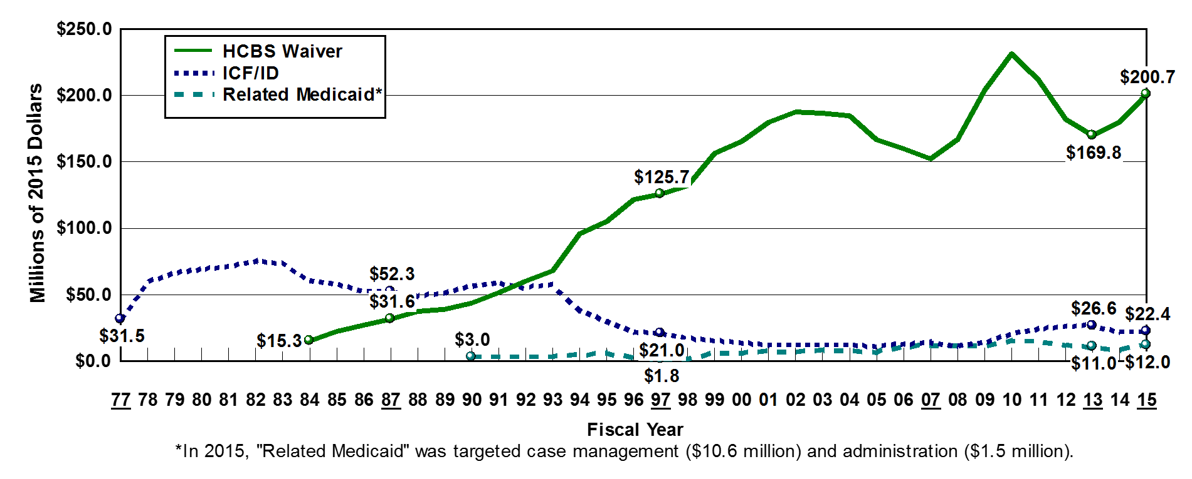
Federal IDD Medicaid Spending by Revenue Source in Colorado
Source: Braddock, D., Hemp, R., Tanis, E.S., et al.(2017).The State of the States in Intellectual Disabilities:2017

Slide 40
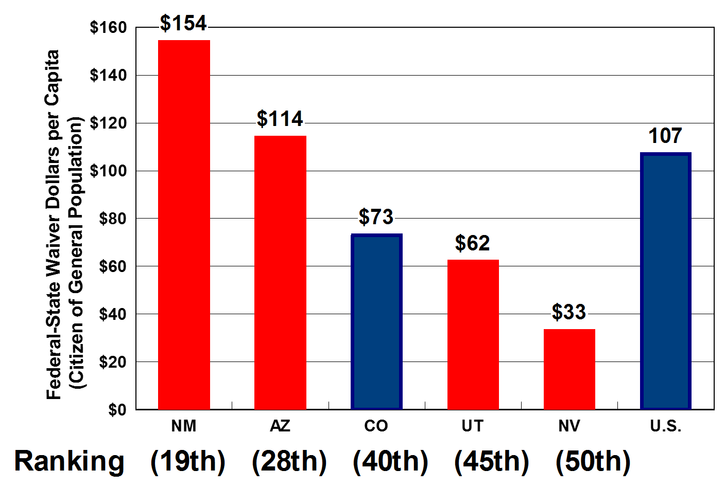
Federal-State Waiver Spending
Per Capita, FY 2015
Source: The State of the States in Intellectual Disabilities Project:2017

Slide 41
Colorado Facts & Rankings FY 2015
Out-of-Home Placements
6th in the % of people with IDD in supervised residential settings for 1-6 people
$269,772 annual cost of care per person for public institutions vs. $13,711 for supported living/personal assistance
Supported Employment
7,507 people in day work programs 34% in supported employment
$14.4 million in spending
Aging Caregivers
Approximately 12,407 people with IDD living with caregivers over age 60 (estimated)
HCBS Waiver
10,538 Waive Participants
$37,500 Adjusted Waiver Cost Per Participant (U.S. average $46,500)
Source: Braddock, D., Hemp, R., Tanis, E.S., et al.(2017).The State of the States in Intellectual Disabilities:2017

Slide 42
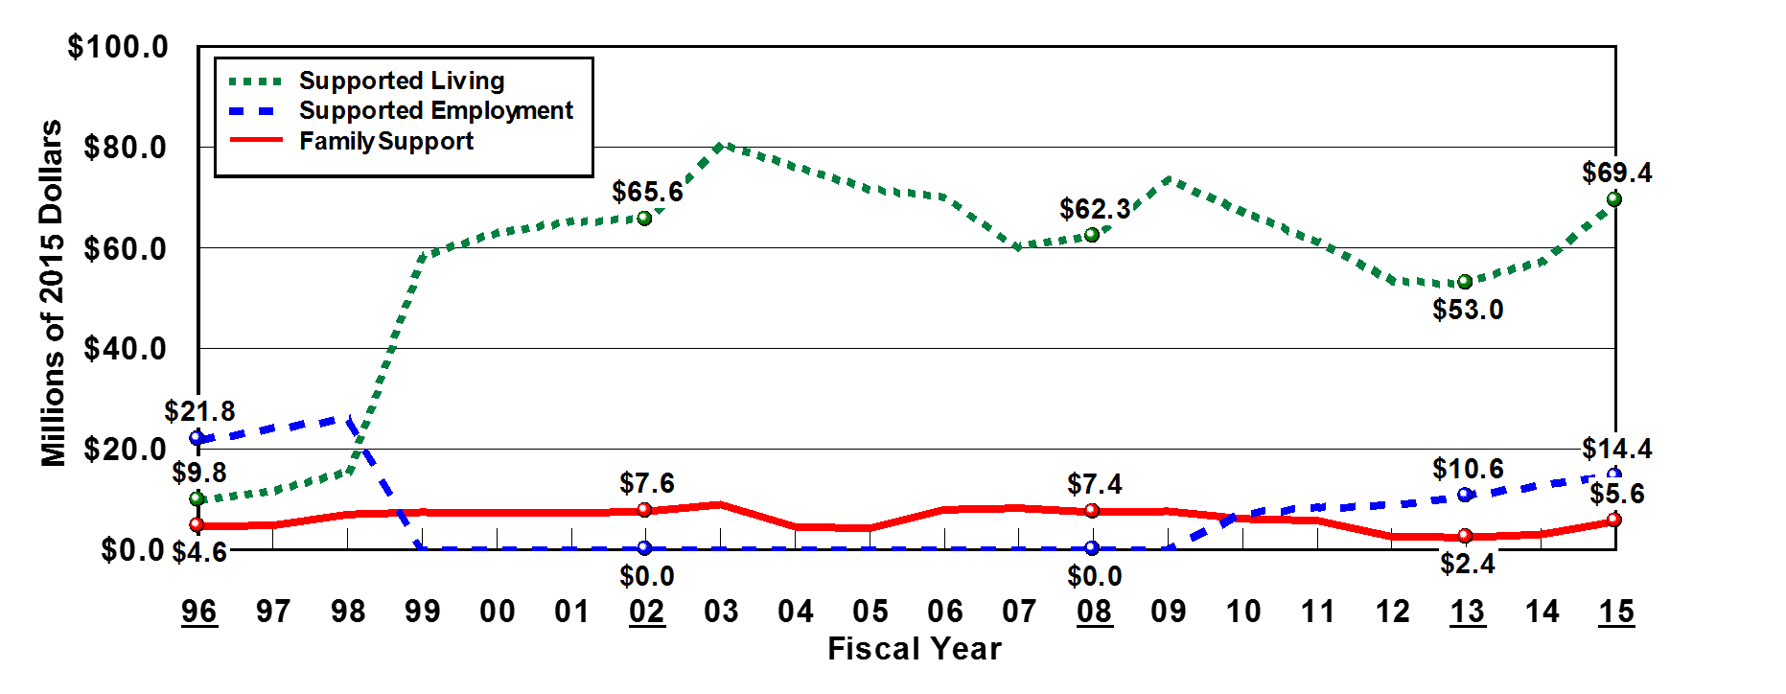
Individual and Family Support Spending in Colorado FY 2015
Source: Braddock, D., Hemp, R., Tanis, E.S., et al.(2017).The State of the States in Intellectual Disabilities:2017

Slide 43
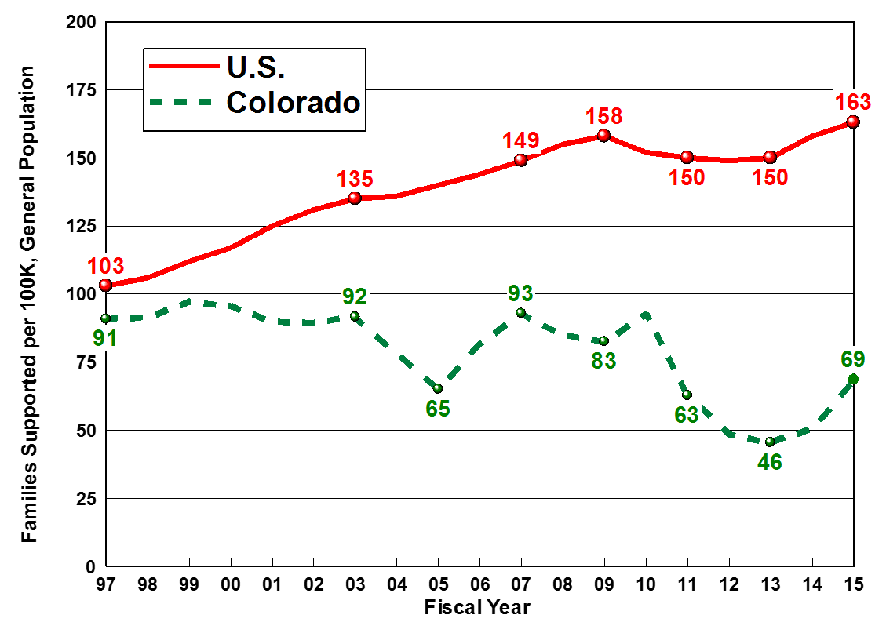
Fewer Families Supported By the State Compared to the U.S.
Source: The State of the States in Intellectual Disabilities Project:2017

Slide 44
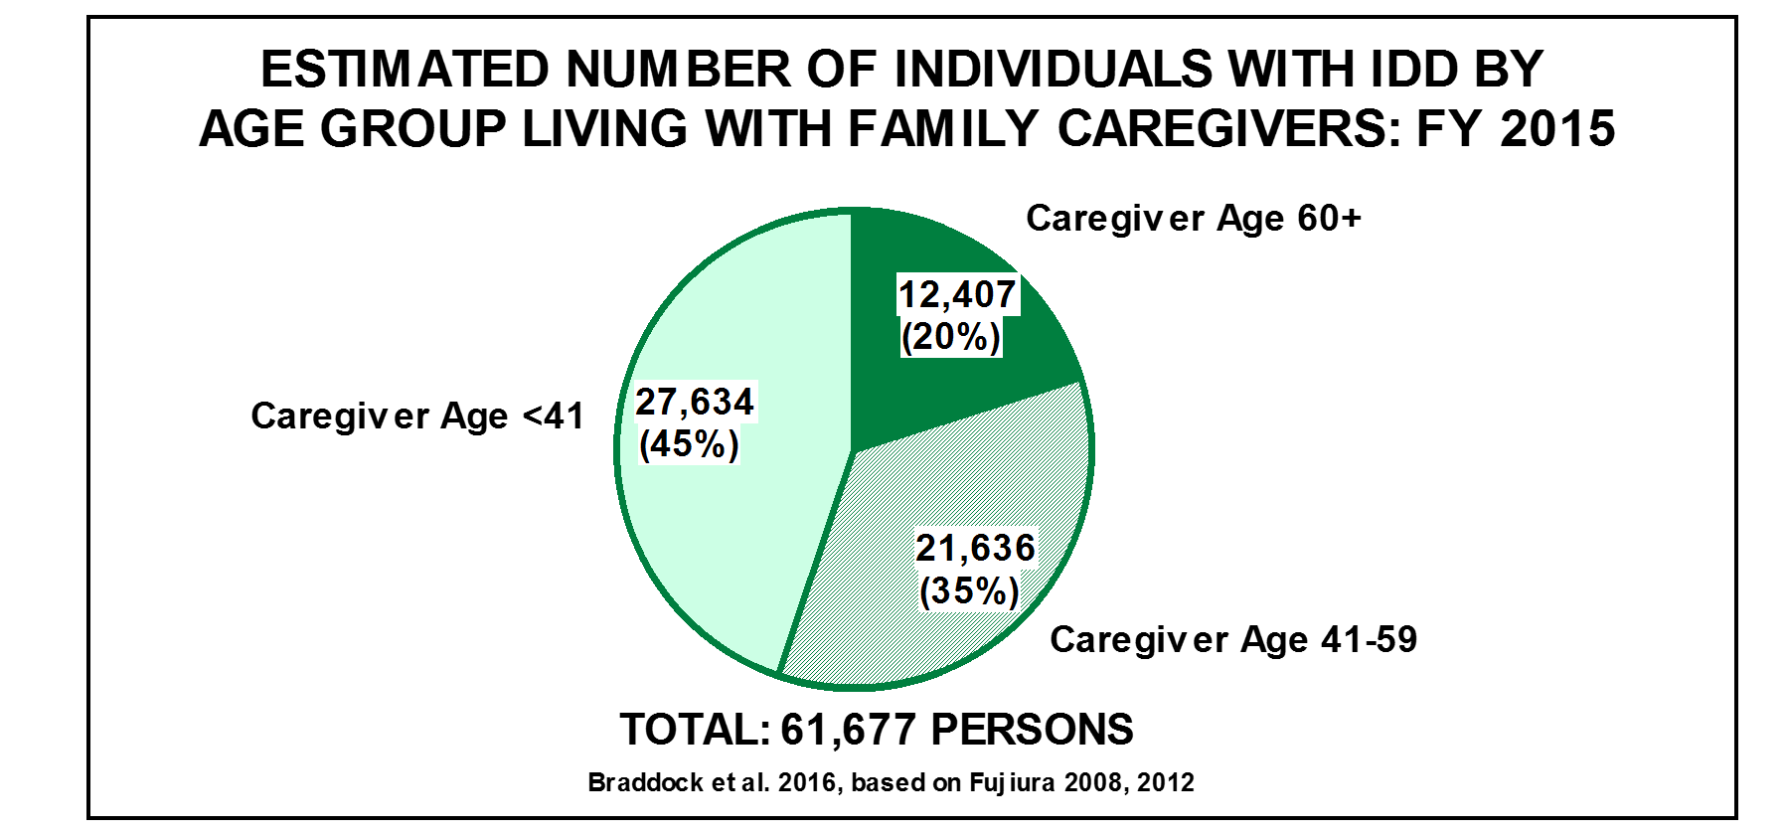
People with IDD in Colorado Living With Family Caregivers
Source: Braddock, D., Hemp, R., Tanis, E.S., et al.(2017).The State of the States in Intellectual Disabilities:2017

Slide 45
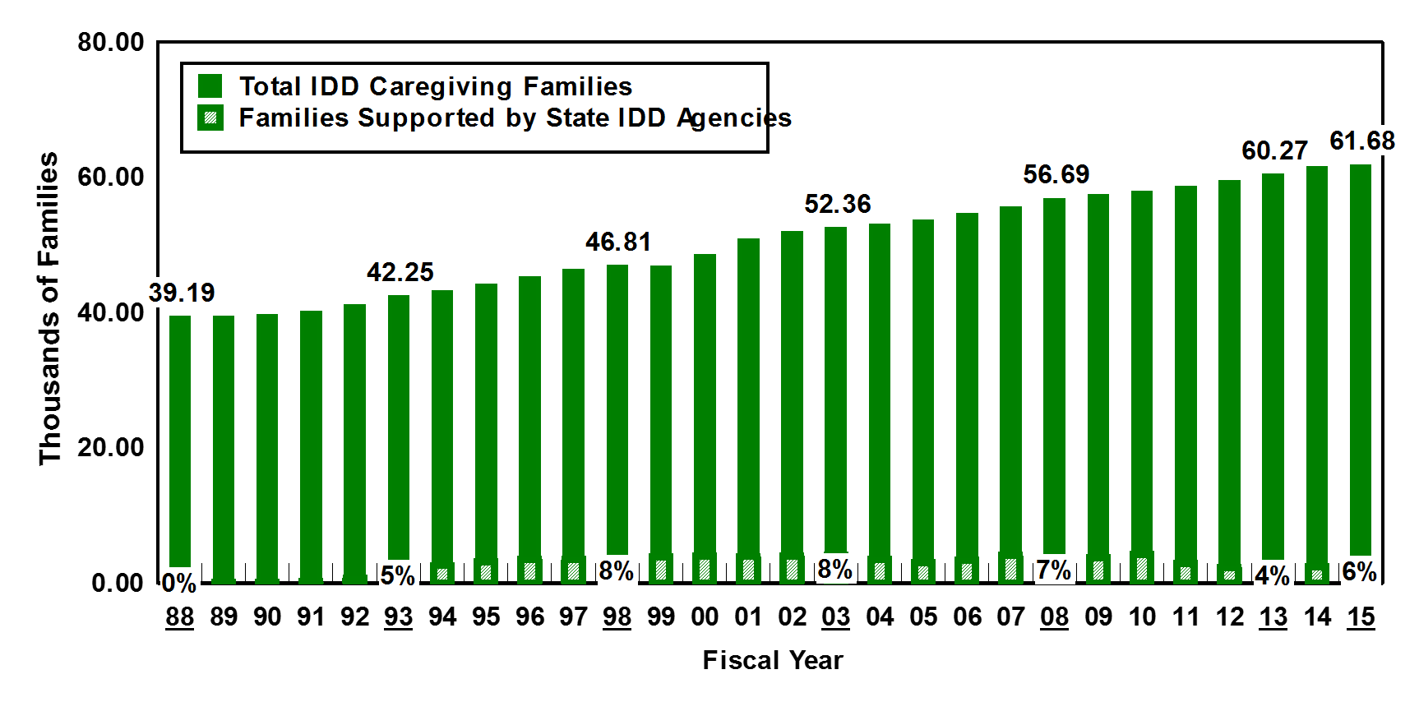
Colorado State IDD Agency Supported Only 6% of Caregiving Families
Source: Braddock, D., Hemp, R., Tanis, E.S., et al.(2017).The State of the States in Intellectual Disabilities:2017

Slide 46
Medicaid Funding
Joint federal-state program
Federal government matches percentage of state spending
Medicaid funds:
  Heath care
  Therapy
  Employment ($903 million for Employment and Day Programs)
  HCBS

Slide 47
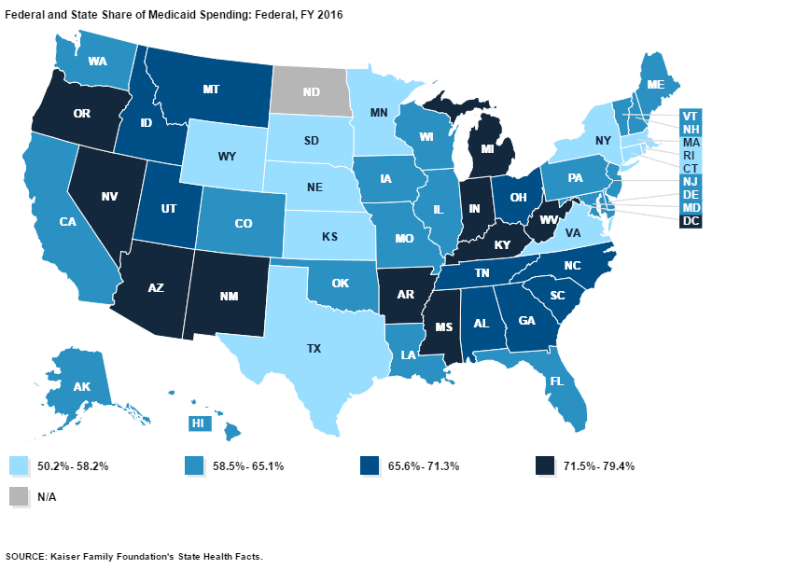
Medicaid Costs are Shared by the States and Federal Government

Slide 48
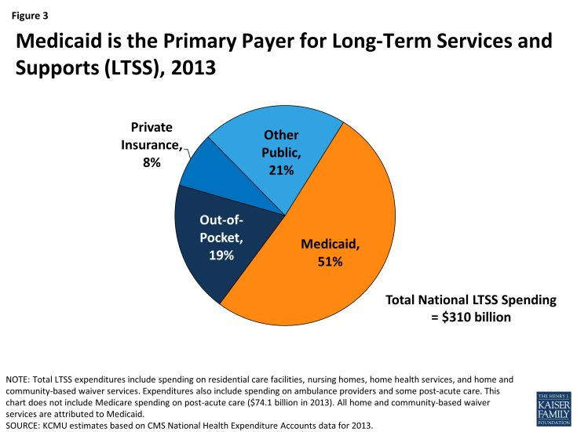
Medicaid is the Primary Payer for Long-Term Services and Supports

Slide 49
Medicaid Continues to be Critical to IDD Long Term Services and Supports
Source: Braddock, D., Hemp, R., Tanis, E.S., et al.(2017).The State of the States in Intellectual Disabilities:2017

Slide 50
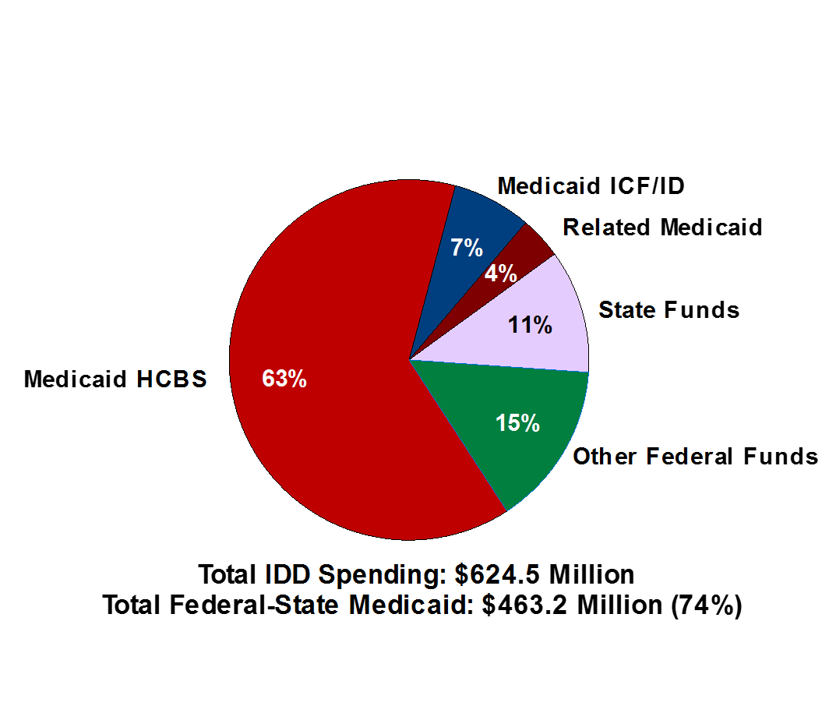
Federal-State Medicaid as a Percentage of Total IDD Spending in Colorado FY 2015
Source: Braddock, D., Hemp, R., Tanis, E.S., et al.(2017).The State of the States in Intellectual Disabilities:2017

Slide 51
President’s Budget
Cuts federal funding by $610 billion by moving to a block grant or per capita cap (gives states the option)
Decreases in federal spending for special education, US DOL Disability Employment Policy, State DD Councils, Autism Programs and Medical Research
Notes:
Senate 142 page bill “Better Care Reconciliation Act” Roll back Medicaid expansion and deep cuts
Goes with a Per-Capita Cap beginning in 2020
Decreases the amount to disability programs by changing the growth rate to CPI-U which is less than the proposed house version
Nutshell CPI-M is projected to grow at 3.7% while CPI-U is projected to grow 2.4%

Slide 52
Affordable Health Care Act – House Bill
23 million uninsured – CBO
$834 billion in cuts
27% of non-elderly adults have a pre-existing condition denied coverage by individual market health insurers prior to the ACA
Under AHCA due to repeal of Medicaid expansion and capped federal matching funds 14 million fewer people would be enrolled in Medicaid by 2026.

Slide 53
Medicaid Per-Capita-Caps
ACHA moves to a per capita cap system and reduces protections for those with pre-existing conditions (option for block grants)
Federal government would offer a fixed amount of money for each beneficiary leading to $834 billion less in federal spending on Medicaid between 2017-2026
A base year of per enrollee spending would be determined and increase over time by a pre-set amount locking in the historical rate
Rates could be determined for all or by groups
Does not address increases in health costs
Insurers could forgo provision of “essential health benefits” (e.g. mental and behavioral health treatment and rehabilitative and habilitative services and devices
Cuts and caps would pressure states to cut HCBS particularly ‘optional’ services
Schools may no longer be considered eligible Medicaid providers risking $4 billion Medicaid that currently reimburses schools
Notes:
Fed sets formula based on # of enrollees that only grows by M-CPI (medical consumer price index, or inflation of prices for medical services) per person
If a state spends more than that, they owe it back the next year (subtracted from their federal funding in the next year
Includes all Medicaid spending including LTSS – makes no considerations for LTSS
Begins in 2020
Tightens pressure on states over time

Slide 54

“Optional Services” are Optional
Home and Community-Based Services Waivers (HCBS)
70% of Total IDD Spending
  Independent Living, Shared Living Self-Direction, Group Homes, All Employment Services
Personal Care Services
Targeted Case Management
Physical Therapy
Speech, Hearing, and Language Disorder Services
Occupational Services
WHAT?!? I NEED THAT!

Slide 55
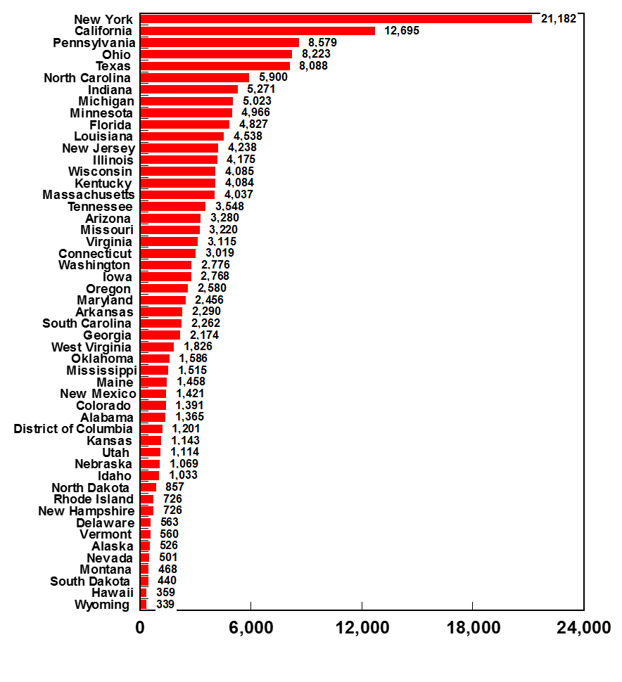
Estimated State-by-State IDD Reductions from Proposed Medicaid Cuts: 2025
166,000 reduction from 920,000
projected recipients with IDD in 2025
Colorado 1,391

Slide 56
AHCA Would Shift $4.3 Billion in Medicaid Costs Over 10 Years
2016 State Share | Projected 2026 State Share | State Share 10 Year Increase | Cumulative AHCA 10 Year Cost Shift to State
$3,375,481,000 | $6,753,411,000 | 100% | $4,301,664,000
 | Total Optional Services Medicaid Expenditures | 1915 (c) Waivers, Other HCBS | Prescription Drugs | Primary Care Case Management | Adult Dental Services | Hospice Benefits | Other
$ Mil. % of Total | $2,256.0 | $1,406.5 62.3% | $485.7 21.5% | $150.0 6.6% | $80.9 3.6% | $60.5 2.7% | $72.4 3.2%
Health Management Associates (2017). Medicaid Reform Impact Model: 50 States

Slide 57
Colorado Health Institute
$14 billion cut in state revenue
$340 million cut during first year
“The Colorado’s General Assembly will have no choice but to reduce services, cut optional services, restrict eligibility, and increase waiting lists.”

Slide 58
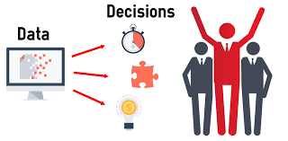
Data is Power

Slide 59
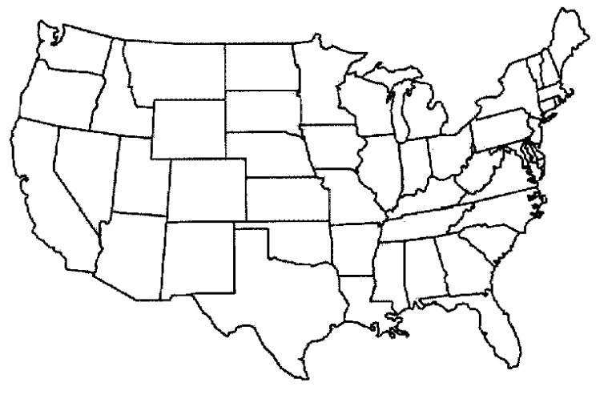
State of the States Website
www.StateoftheStates.org
1. Total Fiscal Effort for I/DD Services
2. Community Fiscal Effort for I/DD Services
3. Institutional (16+) Fiscal Effort for I/DD Services
4. Community Spending as a Percent of Total I/DD Services
5. Percent of Total Out-of-Home Placements in Settings for 6 or Fewer Persons
6. Percent of Total Statewide I/DD Caregiving Families Supported by State I/DD Agencies
7. Aging I/DD Caregivers as Percent of Total Persons with I/DD
8. Individual and Family Support Spending per Capita
9. Home and Community Based Services (HCBS) Waiver Federal-State Spending per Capita
10. Average Annual Cost of Care in State-Operated 16+ Person I/DD Institutions
11. Average Daily Cost of Care in State-Operated 16+ Person I/DD Institutions
12. Nursing Facility Residents with I/DD, Per 100,000 of the State Population
13. Six-or-fewer Person Community Spending as a Percent of Total I/DD Spending
14. Unmatched State Funds Potentially Available to Match Additional Federal Medicaid Funding
15. Medicaid Percent of Total I/DD Spending
16. Public Spending for Family Support and Supported Living as a % of Total I/DD Spending

Slide 60
Technical Assistance
Example topics:
  How many people have intellectual and developmental disabilities in my state?
  How many aging family caregivers are in my state?
  How does my state compare to my neighbor state? Other regions?
  How has my state progressed over time in deinstitutionalization, development of family supports, state spending vs. Medicaid spending, etc.?.

Slide 61
For More Information
Shea Tanis, Ph.D.
Shea.tanis@cu.edu
State of the States in Intellectual and Developmental Disabilities
WWW.STATEOFTHESTATES.ORG

Slide 62
Acknowledgement
Special thanks to the Administration on Intellectual and Developmental Disabilities (AIDD), Administration for Community Living for supporting the Longitudinal Projects of National Significance.
WWW.ACL.GOV

Slide 63


Slide 64
Technology Spending
6 States support Remote Monitoring
5 States support Other Technology
Remote Monitoring $2,658,501
  539 Participants
Personal Technology $4,057,539
  1,738 Participants

