Slide 1
HCBS Settings Final Rule Implementation
Updates for Fiscal Year 2016-2017
Leah Pogoriler

Slide 2
HCPF Mission

Slide 3
Overview
Federal Home and Community Based Services (HCBS) Settings Final Rule
Progress in Fiscal Year 2016-2017
Timing
Next steps

Slide 4
Federal HCBS Settings Final Rule
Criteria to ensure that settings where people receive HCBS are integrated in the community and non-institutional
Additional criteria to ensure that provider-owned or -controlled residential settings are homelike

Slide 5
Progress in Fiscal Year 2016-2017
Updated Statewide Transition Plan (STP.4)
Updated systemic assessment crosswalk
Updated our website (https://www.colorado.gov/pacific/hcpf/home-and-community-based-services-settings-final-rule)
Completion pending for randomly selected site visits
Developed registry of affected HCBS settings
Developed web-based Provider Transition Plan (PTP)

Slide 6
Why a web-based PTP?
Easier to complete and to revisit/review/update
Collects additional information (e.g., potential cost impacts)
Allows for more real-time reporting on status of settings statewide

Slide 7
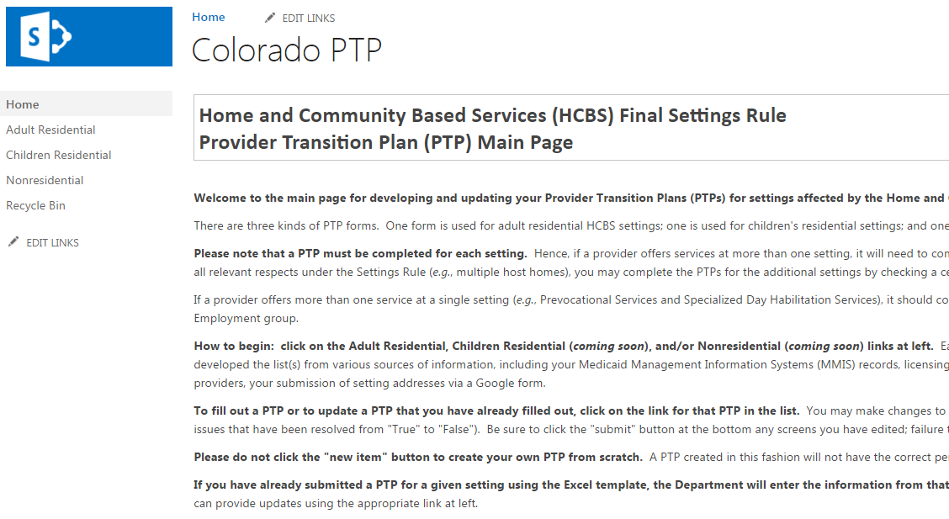
The web-based PTP

Slide 8
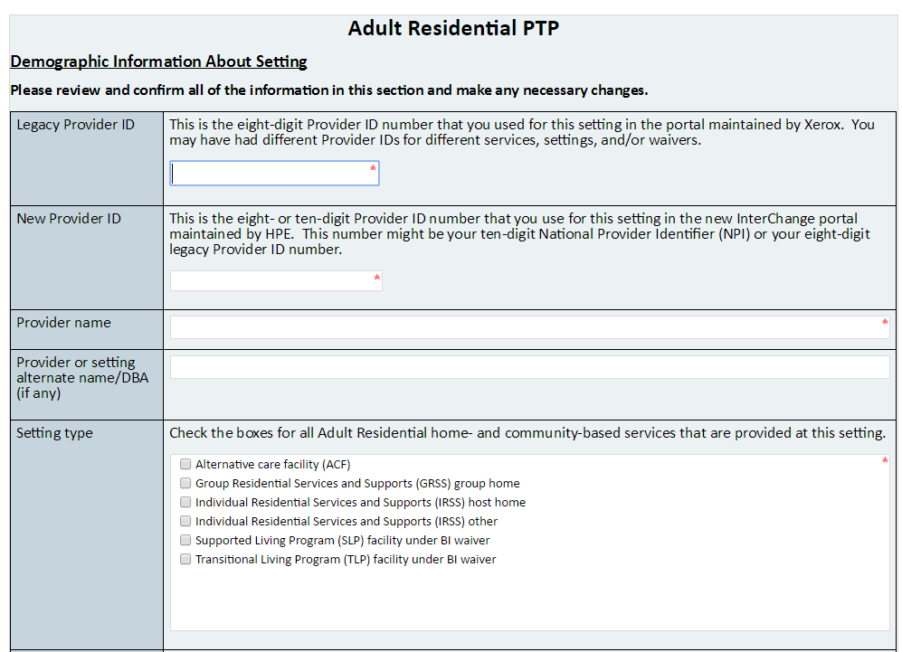
The web-based PTP (cont.)
Notes:
Basic information about each setting will be prepopulated in the PTP
Optional certification

Slide 9
The web-based PTP (cont.)
This form was previewed during the June 8 and 12 webinars
Do we have your current email address?
We plan to offer additional webinars

Slide 10
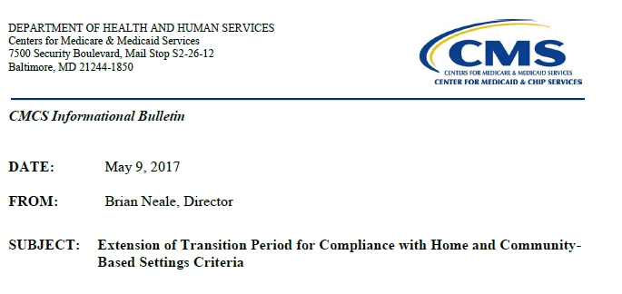
Timing
[some material omitted]

Slide 11
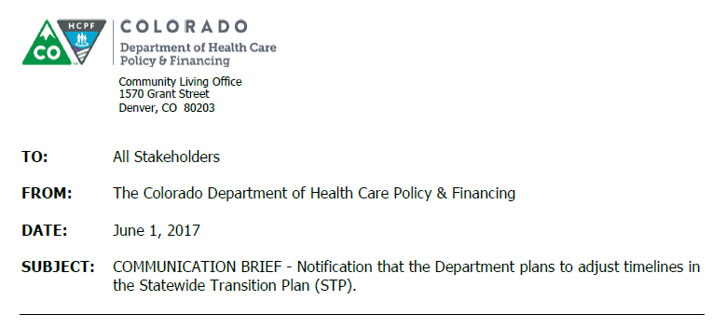
Timing (cont.)
[some material omitted]

Slide 12
Next Steps
Invite providers to SharePoint & offer more webinars
Enter information from Excel PTPs into web-form
Conduct additional site visits (CDPHE)
Prepare more detailed responses to public comments received in June 2016 (→ CMS initial approval) & respond to comments received in March 2017
Defer edits to STP and crosswalk until we receive CMS’s expected comments accompanying initial approval
Notes:
From Communication Brief: Concurrently, the Colorado Department of Public Health and Environment (CDPHE) will work with all providers completing Provider Transition Plans and updating their policies and procedures. Moreover, CDPHE will conduct ongoing site visits throughout the state, including at settings where providers request a site visit to obtain more direct input and assistance; settings not included in the universe from which random selections were made in Fall 2016 (e.g., those operated by new providers or identified later); settings that were already visited and are working through compliance with the Final Rule; a selection of family-caregiver-owned homes sufficient to test the presumption in the STP that these settings comply with the federal requirements; and any additional settings where the Departments may have concerns about potential noncompliance (e.g., based on responses to the Individual/Family/Advocate Survey that are identifiable to a particular setting).

Slide 13
Next Steps (cont.)
Answer frequently asked questions (FAQs)
E.g., how to comply with the requirement of a lease or residency agreement providing certain protections
The web-based PTP will remain open so you can change your compliance issues and/or remedial action plans
Report on Individual/Family/Advocate (IFA) Survey responses received to date
Revise IFA Survey to make it more user-friendly and relevant to goals of STP

Slide 14
Questions or Concerns?

Slide 15
Contact Information
Leah Pogoriler
Strategic Policy Advisor
leah.pogoriler@state.co.us
Lori Thompson
HCBS Specialist, Division for Intellectual and Developmental Disabilities
Lori.Thompson@state.co.us

Slide 16
Thank You!

