Slide 1



MULTIMEDIA PORTFOLIOS
Matching Individual Talent with Business Needs

Slide 2
Introductions
Katie Taliercio
DDRC Self-Advocacy &
Self-Determination Initiative Coordinator
Pat Jefferson
DDRC Director of Access and Community
HIPAA Privacy Officer
Keith Frambro, CHPS
DDRC Director of Information Technology
HIPAA Security Officer

Slide 3
Presentation Review
First job
A new way to think about assessments
Storytelling
Multimedia Portfolios
Balancing HIPAA regulations with the right to participate on the internet

Slide 4

What was
your
first job?

Slide 5
Did you participate in a
situational assessment
before you got that job?

Slide 6
What is Self-Advocacy and
why does it matter in a job search?

Slide 7

Self-Advocacy is
intimate, personal,
and brave
Self-Advocacy is not
a comparison with others
Self-Advocacy is a journey

Slide 8
Self-Advocacy is Telling Your Story
  What are the things you do that show your gifts and talents?
  Who knows you well and can speak to your strengths?
  What are some of your passions and hobbies?

Slide 9
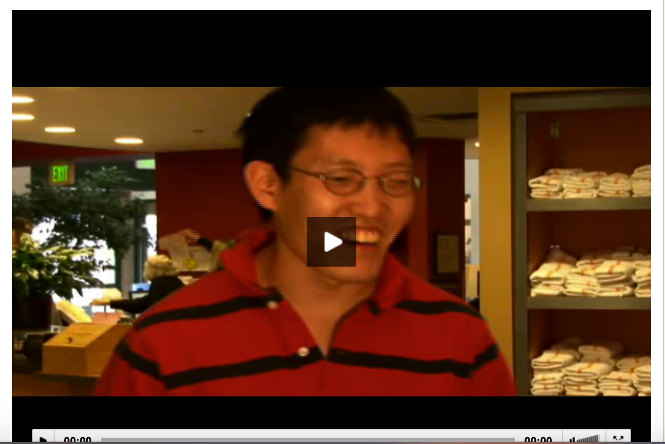
Erik’s Video Resume
http://employmentgateway.org/erik

Slide 10


Slide 11

Multimedia Portfolio
All on one site
Video Resume
Highlighted Career Objectives & Strengths
Benefits to Hiring Me
More About Me
Traditional Resume Information

Slide 12
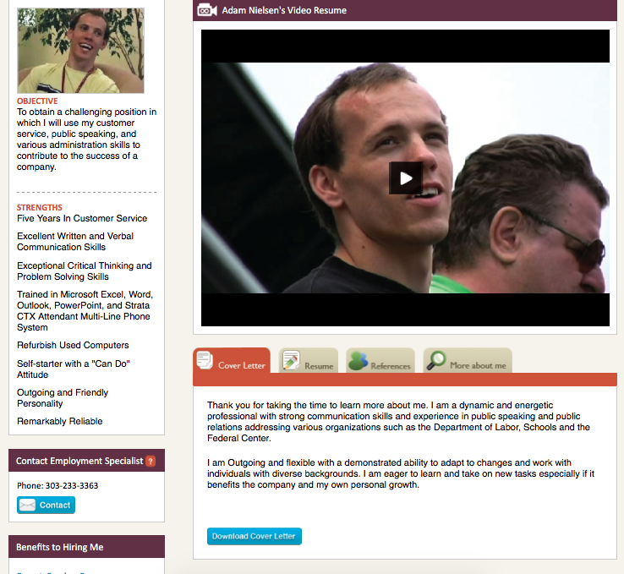
Objective
cool
Strengths
Contact
Employment Specialist
Benefits to
hiring me
Resume
Cover Letter
References
More
about me

Slide 13
Implementation Challenges
Privacy
Security
Funding
Evaluation
Marketing

Slide 14
HIPAA
Privacy Concerns
Information posted never really disappears?
Who gathers and view the content?
Where is the content stored?
Who provides consent?
What are they consenting to?

Slide 15
HIPAA
Security Concerns
Where if the content stored?
Is the content encrypted?
Who has access to the content?
How to avoid security breaches?

Slide 16
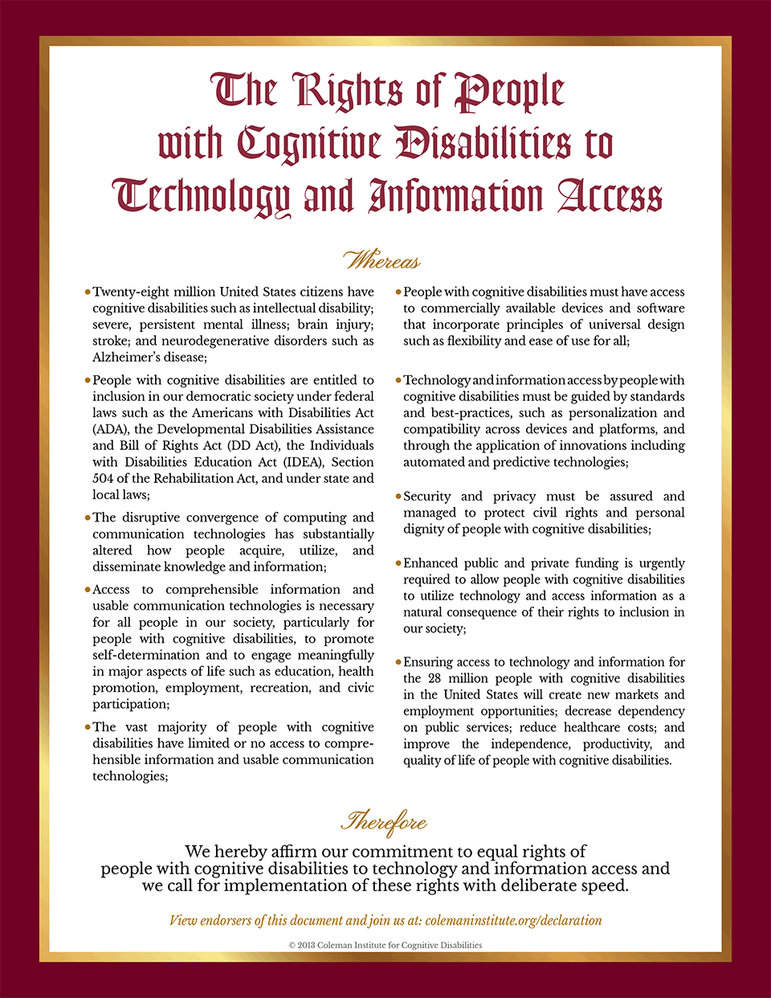
Declaration

Slide 17

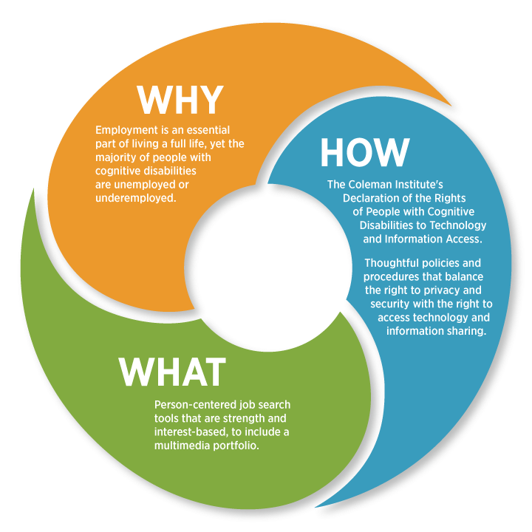

Declaration Implementation Grant
Balancing the Right to Privacy and Internet Participation

Slide 18
Covered Entity
Hybrid Entity
Regulatory
Informed consent HIPAA Compliant Authorization
Business Associate Agreement
Agency HIPAA privacy and security policy
Administrative tracking requirements
Health and Human Services
Office of Civil Rights
Office of Inspector General
State Attorney General
Best business practices
Firewalled from PHI
Informed consent- Disclaimer
Non-disclosure and terms of service
Internal policy for retaining rights or access to content
State Attorney General

Slide 19
Employment Gateway Logistics
Discovery and production outline for video
Filming and editing
Gathering content for all other portfolio sections (including pictures and links)
Enter data into web portal
Password protection
Agreements and Consents
Share link with prospective employers

Slide 20
Cost
  Multimedia portfolio between $1300 to $1800
    Professional video resume
    Portfolio content gathering
    Administrative and staff
    Web hosting
How much is spent now for a situational assessment?

Slide 21
Funding
Started through DDRC Self-Determination Initiative using Board Approved Local Funding
Prospective future funders:
    Division of Vocational Rehabilitation
    American Job Centers
    Medicaid Waiver
    Grants
    Private pay

Slide 22


Slide 23

Questions and / or Ideas

Slide 24
For more information contact:
Katie Taliercio
DDRC Self-Advocacy and
Self-Determination Initiative Coordinator
katie.taliercio@ddrcco.com
303-462-6528
Thank you for your time and interest!

