Slide 1


Using Outcomes Based Data for Improving Service Quality and Monitoring
Jeff Shoemaker
Quality Enhancement Specialist

Slide 2
ACCREDITATION
CERTIFICATION
ORGANIZATIONAL
TRANSFORMATION
TRAINING
CONSULTATION
DATA

Slide 3

THE HISTORY OF CQL
The Accreditation Council
Wyatt v. Stickney
ACF/DD Standards
CQL
The ACF/MR was established through an MOA with JCAH
ACF/MR standards are used as basis for 35 Wyatt standards
…are consolidated into one set
The Council on Quality and Leadership
1971
1973
1979
1969
1972
1977
1997
ACF/DD Standards
ACF/DD Standards
ACMRDD
First edition of standards are developed – focus on large residential facilities
Standards are adapted for use by DHEW for certification of ICFs/MR.
Accreditation Council publishes second set of standards for community settings
The Accreditation Council for MRDD
Notes:
CQL was established in 1969 and we started out as an accreditation entity that worked in collaboration with JCAHO and really focused on making sure that agencies were in compliance with rules and regulations. We realized, however, that organizations were in compliance with standards but people were not living quality lives. So 10 years later we became our own not-for-profit.
Some notable events in CQL history include the 1971 release of quality standards – which later were adapted and became the ICF/DD standards
Our standards were also used in the historic Wyatt v. Stickney case in Alabama…
In 1997 we changed our name to CQL

Slide 4
DEFINITIONS OF QUALITY
QUALITY
ENHANCEMENT
Personal Outcome
Measures®
QUALITY
ASSURANCE
Basic
Assurances®
Notes:
QA – non-negotiables (Quality Assurance metrics) – those measures that capture health, safety, and human security – we use a tool called the Basic Assurances to measure these things.
Then there are quality enhancement efforts that go beyond mere compliance – the things that capture what really matters to people. We determine this through a tool called the Personal Outcome Measures. It is an interview with the person receiving support where we determine how they measure what is really important in 21 areas of life that are important to us all.

Slide 5
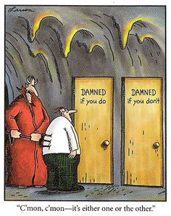
Self Determination & Choice
Notes:
In the past 24 years, we have interviewed close to 10,000 people who have disabilities. We ask them about their choices. Only 35% chose where they worked, only 30% chose their services, and only 26% chose where and with whom they lived.
So as an organization, what are you doing to promote choice? And not the choice between bowling and walking around the mall – but real choice?

Slide 6

PERSONAL
OUTCOME MEASURES®

Slide 7
PERSONAL OUTCOME MEASURES®
THE HISTORY
Focus Groups
POMs
21 Outcomes
Validity Testing
With people with DD, people with mental illness, parents, thought leaders
The first Personal Outcome Measures tool is published – 30 outcomes. Validity testing conducted.
Analysis of the data leads to the combination of certain outcomes resulting in the 21 outcomes we use today
Researchers at the UMN conduct additional validity testing
1992-1993
1997
2017
1991 - 1992
1993
2005
2017
Piloted
25 Outcomes
Revalidation
In three orgs and then field tested in US and Canada
Factor analysis reduces the number of outcomes from 30 to 25
Analysis demonstrates the continued validity of the 21 outcomes

Slide 8

WHAT MATTERS TO YOU?
Think about things
that matter most
in your life …

Slide 9
YOU MAY HAVE SELECTED
FAMILY
SUCCESS
HOME
WORK
MONEY
FUN
LOVE
SPIRITUALITY
HEALTH
FRIENDS
Notes:
They really are the same things that people with disabilities want.
And we find that staff change behaviors when they know and understand people as individuals with priority outcomes similar to their own

Slide 10

PERSONAL OUTCOME MEASURES®
IT’S PERSONAL
Personal outcomes are defined by the person, therefore, have no standard definition
Are different for everyone
The Personal Outcomes evolve over time and individual definitions may change
Require listening and understanding the person from their perspective.
Notes:
Outcomes are defined by people based on their own experiences
So what is “best possible health” to you? To one person it may be losing weight or quitting smoking, another person may want more work/life balance, or to regain mobility, get off meds, get out of rehab

Slide 11






PERSONAL OUTCOME MEASURES®
THE FIVE FACTORS
MY HUMAN SECURITY
MY COMMUNITY
MY RELATIONSHIPS
MY CHOICES
MY GOALS

Slide 12

PERSONAL OUTCOME MEASURES®
MY HUMAN SECURITY
People are safe
People are free from abuse and neglect
People have the best possible health
People experience
continuity and security
People exercise rights
People are treated fairly
People are respected
Notes:
So these are the non-negotiables

Slide 13

PERSONAL OUTCOME MEASURES®
MY COMMUNITY
People use their
environments
People live in
integrated environments
People interact with other members of the community
People participate
in community life

Slide 14

PERSONAL OUTCOME MEASURES®
MY RELATIONSHIPS
People are connected
to natural support networks
People have friends
People have intimate relationships
People decide when to
share personal information
People perform
different social roles

Slide 15

PERSONAL OUTCOME MEASURES®
MY CHOICES
People choose where and
with whom to live
People choose where to work
People choose services

Slide 16

PERSONAL OUTCOME MEASURES®
MY GOALS
People choose personal goals
People realize personal goals

Slide 17



OUTCOMES
A MATTER OF DEFINITION
CLINICAL OUTCOMES
Cure and symptom reduction
FUNCTIONAL OUTCOMES
Increasing functional status
PERSONAL OUTCOMES
Issues that matter most to people in their lives
Notes:
Historically we measured clinical and functional

Slide 18

PERSONAL OUTCOME MEASURES®
TWO AREAS MEASURED
Outcome for the person as defined by the person
Individualized supports to assist the person to attain each outcome

Slide 19
QUALITY IN SERVICES
OUTCOMES & SUPPORTS
=
Outcome
for the Person
Individualized
Supports
QUALITY
OF LIFE
=
QUALITY
OF SERVICES
Notes:
It is only possible to measure individualized supports by first identifying the outcome
Personal outcome and support questions go together

Slide 20
PERSONAL OUTCOME MEASURES®
OUTCOMES & SUPPORTS
Individualized supports are not:
      A policy, procedure or program
Individualized supports are:
      - The specific application of the policy,
      procedure or program to enable a person to
      achieve his or her outcome
Notes:
INTERVIEW?

Slide 21
Information-Gathering
When A Person Communicates Differently
Find out the person’s preferred method of communication
Talk to people (family, staff, others) who know them best to get advice and information
Make sure communication supports are available
Be aware of environmental factors
Look to the person for direction
Wait for responses
Ask one question at a time
Summarize to see if you got it right
Spend time with the person where they live, work and play
Notes:
Everyone communicates. The person is never excluded from the meeting, even if we have difficulty communicating with them. It is up to us to figure out what the person is communicating.

Slide 22
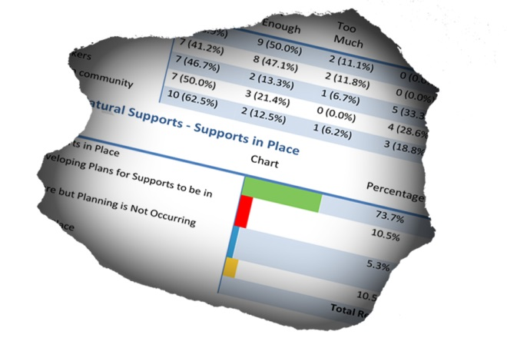
Data
Drives
us.
“The CQL database
that we’re using is so amazing.”
-Laura Vegas, TN DIDD

Slide 23
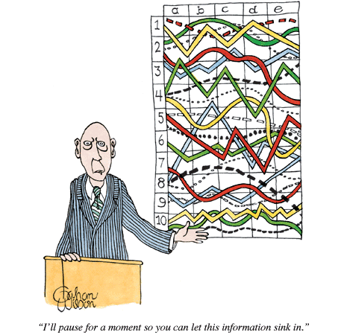
DATA COLLECTION
DATA OVERLOAD
Collecting data is only valuable
if you do something meaningful with it:
Guide individual plan
Provide agencies with information
to make data-based decisions
Give states the information
they need to demonstrate
compliance, set priorities,
and focus limited resources

Slide 24
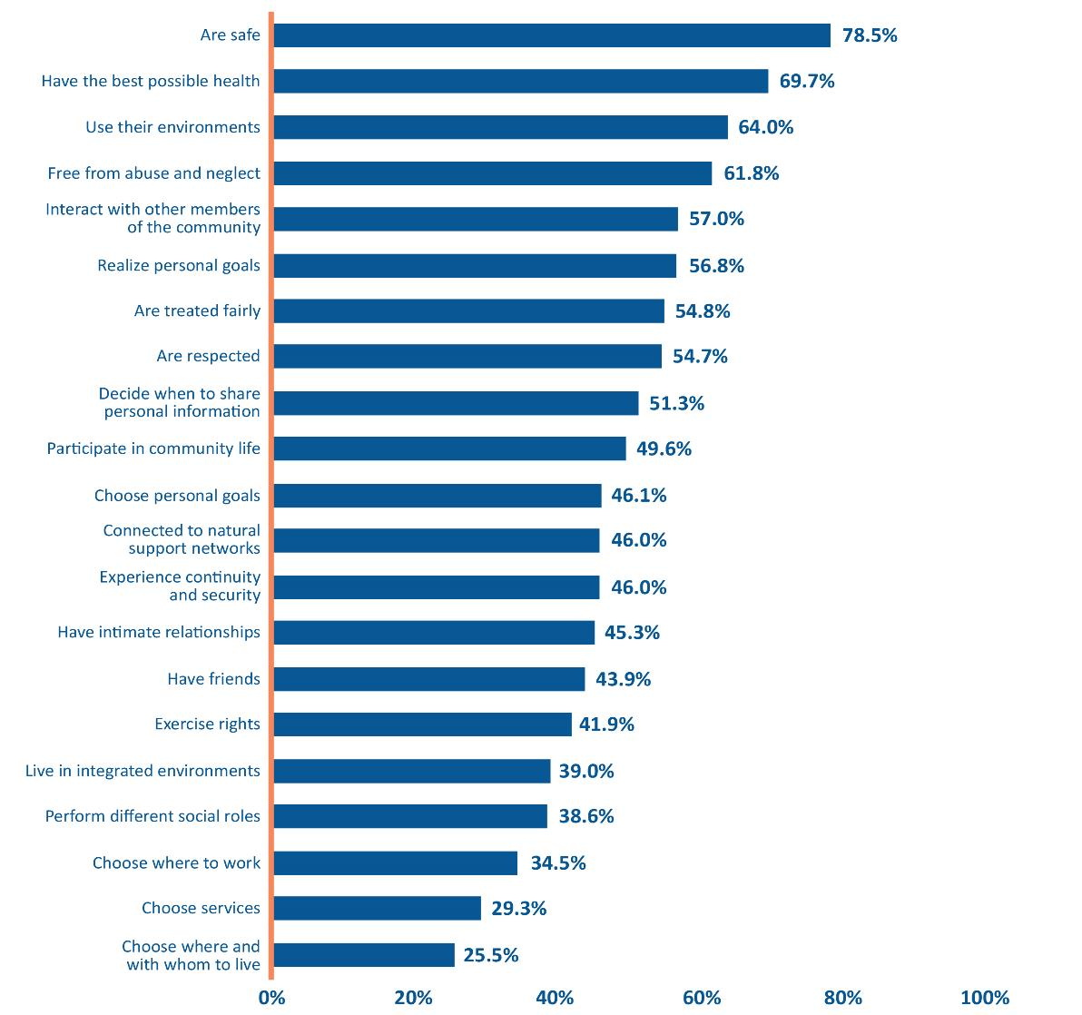
20 YEARS OF DATA
OUTCOMES PRESENT
Notes:
2016

Slide 25
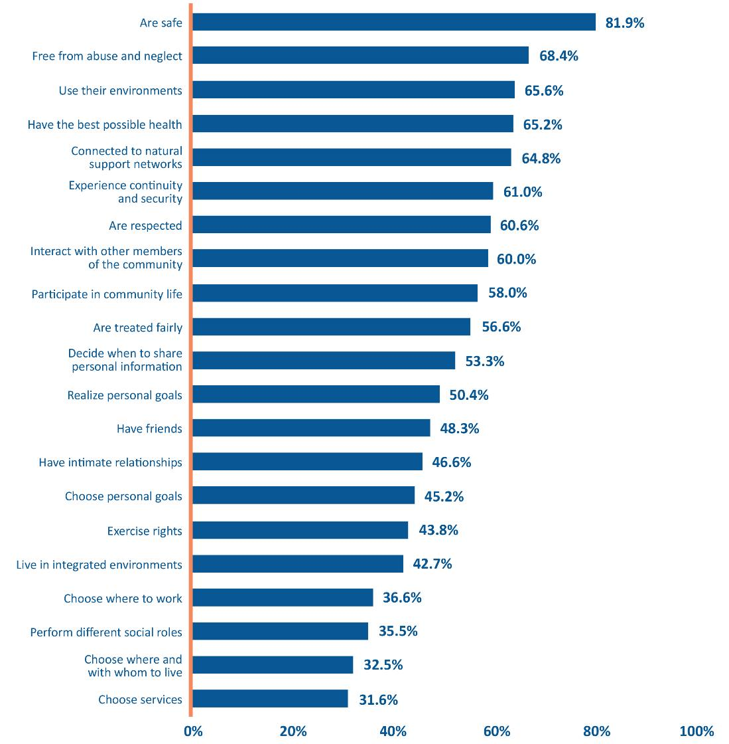
SUPPORTS PRESENT
Notes:
2016

Slide 26
Notes:
Examples of what can be done with data.
Not only are we having a hard time finding DSPs, we’re also having a hard time keeping them. And our interviews show us some of the people we support experience greater turnover than others. People with behavioral challenges we talked to almost all experienced turnover in the past 2 years. It doesn’t get much better for groups with less intense support needs.

Slide 27
Notes:
As setting size gets larger people are more likely to see DSP turnover. Almost 100% of the people we interviewed in settings for 20 or more experienced turnover in the past 2 years.
This is very upsetting for the people we support. Their home is like a revolving door.

Slide 28
Difference in likelihood to achieve outcome when
there is DSP turnover vs when there is not …
(n = 1,443)
Notes:
The difference between odds of having outcome present when the person experiences no turnover and the odds when they do experience turnover. For example, people who experience turnover are 43% less likely to have continuity and security than people who do not experience turnover. The turnover is impacting them, and affecting their quality of life.

Slide 29
Did the person decide where to work, by setting?
(n = 1,443)
Notes:
And this varied by setting. Some people worked in more than one setting…
So of the 290 people we talked to in sheltered workshops, 79 (or 27%) said they chose to work there.
Conversely, 76% of the people we talked to in competitive employment said they chose their job.

Slide 30
Residence Type | Intimate Relationships
Notes:
For valentines day we looked at intimate relationships – we found people living in the family home were more likely to report having people in their life that loved them and who loved them back (59%) versus the folks we talked to in provider run group homes (41%) or ICFs (43%).

Slide 31
The odds of people with disabilities
having intimate relationships is …
(n = 1,443)
HIGHER
WHEN
Organizations address barriers to close personal relationships
HIGHER
WHEN
Organizations assist choices regarding close personal relationships
8X
10X
HIGHER
WHEN
Organizations know the person’s preferences regarding intimate relationships
Organizations support close personal relationships
HIGHER
WHEN
Individualized supports are in place for close personal relationships
11X
20X
Notes:
What happens when organizations provide this support? Well it increases the chances of people actually having this outcome present in their life.

Slide 32
HOW TO USE THE DATA
ORGANIZATIONAL CHANGE
“It’s all very central to our strategic planning. We really look at all of our data to examine where we’ve been and where it is that we want to go,” says Kim Zoeller, President and CEO of Ray Graham Associates, adding, “We plan with that data; everything from our staff training, to how we budget our funds, to whether or not we create a new initiative to better support people.”
“Personal Outcome Measures® isn’t something we do. It’s everything we do.” Kim Zoeller.
Notes:
When aggragated, the data can help organizations plan and determine how to spend their resources (for training, etc). This is a quote from the executive director of one of our accredited agencies.

Slide 33

HOW TO USE THE DATA
STATEWIDE SYSTEMS CHANGE
"While transition plan approval is the first of many steps, we believe our ongoing work through CQL’s Network Accreditation process has perfectly positioned us to be successful in coming into full compliance with the CMS Settings rules.”
Debra Payne, Commissioner of the Tennessee Department of Intellectual and Developmental Disabilities (TN DIDD).
Notes:
And finally we work with states to incorporate our data into their QA and QE efforts. For example, we worked with Tennessee on network accreditation – so the entire state DIDD system is accredited. They did a statewide Basic Assurance self assessment and we are helping them incorporate the BA and POMs into their provider manuals, human rights committee policies, etc.
In Alabama, they have incorporated our BA and POMs into their administrative code.
In SD, they used our data to demonstrate site specific compliance in their state transition plan.
Again, it’s only useful if you do something with it.

Slide 34
18% decrease between 1995 - 2015
17% increase between 1995 - 2015
23% increase between 1995 - 2015

Slide 35
7% decrease between 1995 - 2015
8% increase between 1995 - 2015

Slide 36
9% decrease between 1995 - 2015
10% increase between 1995 - 2015
9% decrease between 1995 - 2015

Slide 37
7% decrease between 1995 - 2015
5% increase between 1995 - 2015

Slide 38
6% increase between 1995 - 2015
10% increase between 1995 - 2015

Slide 39
https://c-q-l.org/resource-library/toolkit-for-states

Slide 40
New Requirements for Home and Community-Based Settings | CQL Basic Assurances®: Organization Level Data Available | Personal Outcome Measures®: Individual Level Data Available
REQUIREMENT 1: The setting is integrated in and supports full access of individuals receiving Medicaid HCBS to the greater community, including opportunities to seek employment and work in competitive integrated settings, engage in community life, control personal resources, and receive services in the community with the same degree of access as individuals not receiving Medicaid HCBS.
The setting is integrated in and supports full access to the greater community. | Yes | Yes
There are opportunities to seek employment and work in competitive integrated settings, engage in community life, and control personal resources. | Yes | Yes
The individual receives services in the community with the same degree of access as individuals not receiving Medicaid HCBS. | Yes | Yes
REQUIREMENT 2: The setting (home or community-based) is selected by the individual from among setting options including non-disability specific settings and an option for a private unit in a residential setting. The setting options are identified and documented in the person-centered service plan and are based on the individual’s needs, preferences, and, for residential settings, resources available for room and board.
The setting is selected by the individual from among residential and day options that include generic settings. | Yes | Yes
The setting provides the participants an option to choose a private unit in a residential setting. | Yes | Yes
The setting options are identified and documented in the person-centered service plan and are based on the individual’s needs, preferences, and, for residential settings, resources available for room and board. | Yes | Yes
REQUIREMENT 3: Ensures right to privacy, dignity and respect, and freedom from coercion and restraint.
Right to Privacy | Yes | Yes
Right to Dignity and Respect | Yes | Yes
Freedom from Coercion and Restraint | Yes | Yes
REQUIREMENT 4: Optimizes individual initiative, autonomy and independence in making life choices (including daily activities, physical environment, and with whom to interact). | Yes | Yes
REQUIREMENT 5: Facilitates individual choice regarding services/ supports, and who provides them. | Yes | Yes
Notes:
HCBS crosswalk

Slide 41
Additional New Requirements for Provider Owned/Controlled Residential Settings | Basic Assurances®: Organization Level Data Available | Personal Outcome Measures®: Individual Level Data Available
REQUIREMENT 1: The dwelling is a specific place that can be owned, rented, or occupied under a legally enforceable agreement (e.g., a lease), and the individual has the same responsibilities and protections from eviction that other tenants have under landlord/tenant laws. | Yes | Yes
REQUIREMENT 2: Each individual has privacy in their sleeping or living unit, including: entrance doors are lockable by the individual (staff have keys as needed); individuals sharing units have a choice of roommates in that setting; and individuals have the freedom to furnish and decorate their sleeping unit within the lease or other agreement.
Privacy | Yes | Yes
Choice of Roommates | Yes | Yes
Freedom to Furnish and Decorate their Unit | Yes | Yes
REQUIREMENT 3: Individuals have the freedom and support to control their own schedules and activities, and have access to food at any time.
Control Schedules and Activities | Yes | Yes
Access to Food at any Time | Yes | Yes
REQUIREMENT 4: Individuals are able to have visitors of their choosing at any time. | Yes | Yes
REQUIREMENT 5: The setting is physically accessible to the individual. | Yes | Yes
REQUIREMENT 6: Any modifications to Requirements 1 through 4 above must be supported by a specific assessed need and justified in the person-centered service plan.
Identify a specific and individualized assessed need. | Yes | No
Document the positive interventions and supports used prior to any modifications to the person-centered service plan. | Yes | No
Document less intrusive methods of meeting the need that have been tried but did not work. | Yes | No
Include a clear description of the condition that is directly proportionate to the specific assessed need. | Yes | No
Include a regular collection and review of data to measure the ongoing effectiveness of the modification. | Yes | No
Include established time limits for periodic reviews to determine if the modification is still necessary or can be terminated. | Yes | No
Informed consent of the individual. | Yes | No
Include an assurance that interventions and supports will cause no harm to the individual. | Yes | No
Notes:
HCBS crosswalk

