Slide 1

@SenCoryGardner
@SenBennetCO
Gardner’s office:
(202) 224-5941
Capitol Switchboard
(202) 224-3121
[8 Words or less]
It is a LIFELINE!
It helps people get jobs!
My brother/sister/child/friend’s life depends on it!
Medicaid = Life in the community!
It helps people be independent!
Cutting/capping isn’t the answer!
Community homes, not nursing homes!

Slide 2
Policy Related to Meaningful Community Inclusion: Opportunities and Challenges
Alison Barkoff, J.D.
Director of Advocacy, Center for Public Representation
abarkoff@cpr-ma.org
Colorado Alliance Summit
June 21, 2017

Slide 3
What Is the Vision of a System
For People with Disabilities?
Support people with disabilities to have lives like people without disabilities
Provide opportunities for true integration, independence, choice, and self-determination in all aspects of life – where people live, how they spend their days, and real community membership
Ensure quality services that meet people’s needs and help them achieve goals they have identified through real person-centered planning

Slide 4
Context for Where We Are

Slide 5
Advocacy For Community Services
Until the 1980s, public disability funding only paid for care in institutions
Beginning in 1982, Medicaid created an optional “waiver” program that allowed states to provide community services as an alternative to institutional care
Now every state provides Home and Community Based Services (HCBS) through a range of funding streams, including 1915c waivers, 1915k Community First Choice, and 1915i State Plan HCBS, as well as state plan services and managed care authorities

Slide 6
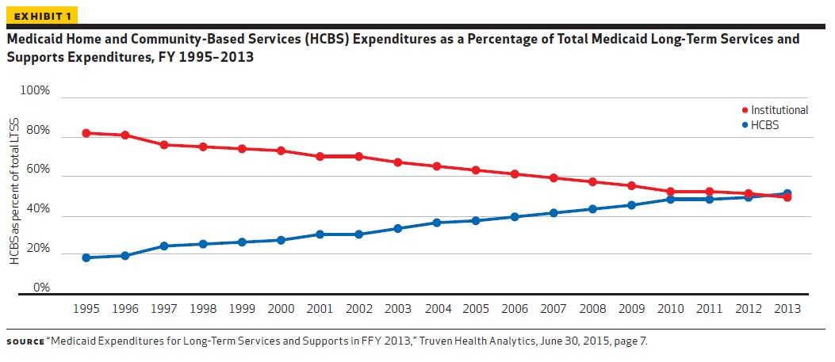
National HCBS vs Institutional Spending

Slide 7
Shift Towards
Community Services (cont’d)
Dramatic shift away from institutional care towards community services
  53% of spending nationally on community services
  Varies by disability (75% of IDD vs. 41% for aging, PD & MH)
  State differences (a low of 27% in Miss to a high of 79% in OR)
Residential: most people with IDD live in small community settings
  In family home (56%), own home (11%), host home (5%) or group home with less than 3 others (5%)
  But still many in larger congregate settings: 4-6 person (12%), 7-15 person (5%) and, 16+ people (6%)
Non-residential: most people still in congregate day services, with only about 20% engaged in competitive, integrated employment

Slide 8
Community Living for People with Disabilities
As a Civil Right
Disability advocates have fought for civil rights laws to protect against discrimination and ensure their inclusion
  Rehabilitation Act of 1974 prohibited discrimination by recipients of federal funding
  Culminated in 1990 with the Americans with Disabilities Act “to provide a clear and comprehensive national mandate for the elimination of discrimination against individuals with disabilities.”
    ADA found that segregation, isolation, exclusion and institutionalization of people with disabilities is a “serious and pervasive problem”
    ADA’s goal is to assure equality of opportunity, full participation, independent living, and economic self-sufficiency for individuals with disabilities.
  Rehabilitation Act of 1973: Prohibits discrimination by recipients of federal money; predecessor to the ADA

Slide 9
The ADA and Olmstead

Slide 10
Title II of the ADA
Prohibits discrimination by public entities in services, programs and activities
Integration regulation requires administration of services, programs and activities in the most integrated setting appropriate
Most integrated setting is one that enables people with disabilities to interact with people without disabilities to the fullest extent possible

Slide 11
Olmstead v. L.C.: Unjustified segregation is discrimination
In 1999, the Supreme Court held that Title II prohibits unjustified segregation of people with disabilities, relying on “two evident judgments” about institutional placement:
  “perpetuates unwarranted assumptions that persons so isolated are incapable or unworthy of participating in community life”
  “severely diminishes the everyday life activities of individuals,” including family, work, education and social contacts

Slide 12
Olmstead v. L.C. (cont’d)
Held public entities are required to provide community-based services when:
  Such services are appropriate;
  Affected persons do not oppose community-based treatment; and
  Community-based treatment can be reasonably accommodated, taking into account the resources available to the entity and the needs of others receiving disability services

Slide 13
When is the ADA’s Integration Mandate Implicated?
Not limited to state-run facilities/programs
Applies when government programs result in unjustified segregation by:
  Operating facilities/programs that segregate people with disabilities
  Financing the segregation of people with disabilities in private placements
  Promoting segregation through planning, service design, funding choices, or practices.

Slide 14
Who Does the Integration Mandate Cover?
ADA and Olmstead are not limited to individuals in institutions or other segregated settings
They also extend to people at serious risk of institutionalization or segregation
  Example: people with urgent needs on waitlists for services or people subject to cuts in community services; students with disabilities who are directly placed by schools into sheltered workshops or segregated day programs.

Slide 15
What is a Segregated Setting?
Have institutional qualities, including:
  Congregate settings with primarily or exclusively people with disabilities; or
  Regimentation in daily activities, lack of privacy/autonomy, limits on ability to freely engage in community activities; or
  Settings that provide for daytime activities primarily with other people with disabilities
  Examples: DD facilities, psychiatric hospitals, nursing homes, adult care homes, sheltered workshops, segregated day programs

Slide 16
What is an Integrated Setting?
Integrated settings provide people with disabilities the opportunity to live, work and receive services in the greater community
  Located in mainstream society
  Offer access to community activities when and with whom the person chooses
  Choice in daily life activities
  Ability to interact with people without disabilities to the fullest extent possible
  Examples: scattered site supportive housing, supported employment in a mainstream job

Slide 17
Need for Olmstead
Enforcement
Despite progress, too many people with disabilities still remain unnecessarily in institutions or other segregated settings
  Ex. DD facilities, psychiatric hospitals, nursing homes, board and care homes, sheltered workshops, and other segregated day settings
Many others at serious risk of entering institutions or segregated settings
  Ex. people on waitlists, using emergency rooms or interacting with police during a mental health crises, homeless individuals with disabilities, or students in the school-to-sheltered workshop
Enforcement activities can be by either DOJ or private plaintiffs (like protection & advocacy organizations)

Slide 18
Olmstead as a “Tool” to
Address These Problems
Using Olmstead to create statewide, systemic reform activities:
  Increasing the capacity of community services that are critical for successful community tenure
  Expanding the supply of affordable, permanent community housing
  Expanding opportunities for employment for people with disabilities

Slide 19
Olmstead as a “Tool” (cont’d)
Ensuring that individuals are given a meaningful choice for the most integrated setting
  Ongoing “in reach” to people in segregated settings:
    Education about services, integrated housing and employment and other integrated day services
    Visits to integrated settings and virtual tours
    Engagement with peers who have transitioned
    Family-to-family supports

Slide 20
Olmstead Guidance & Enforcement
Series of Olmstead guidance documents over the last several years from the Department of Justice:
  Olmstead Q&A
  Olmstead and Employment
  Olmstead and Criminal Justice
DOJ is the agency charged with Olmstead enforcement. But private plaintiff (like P&As and non-profits) can also bring Olmstead lawsuits

Slide 21
Does Olmstead Require States to Provide a Choice of Segregated Services?
Some guardians have tried bringing Olmstead claims to stop closures of state-operated ICFs, citing the decision’s language about choice
Courts have consistently found, consistent with DOJ’s interpretation, that the ADA and Olmstead require states to provide services in integrated settings and not an obligation to provide them in institutions or segregated settings.
Courts have also found that there is no right to remain in a particular institution or segregated setting if a state chooses to close them.
This same rationale would apply to segregated day settings.

Slide 22
Home and Community Based Services (HCBS) Settings Rule

Slide 23
Context for the HCBS Settings Rule
Concerns about segregation and isolation in “community” settings
Changing best practices in services
ADA and Olmstead enforcement challenging settings that segregated people with disabilities yet were funded by HCBS
Extensive public input
  Went through multiple rounds of proposed rulemaking, with thousands of public comments
  Rule morphed from being solely based on size or geographic location to one about individual experiences and community integration in both residential and non-residential services

Slide 24
Opportunities Created by the HCBS Settings Rule
The HCBS settings rule provides an unprecedented opportunity to:
  Expand capacity of more integrated and individualized services
  Move state systems away from outdated, segregated service models
  Help state comply with their obligations under Olmstead

Slide 25
Goal and Scope of HCBS Rule
  To “ensure that individuals receiving services through HCBS programs have full access to the benefits of community living”
  To “further expand the opportunities for meaningful community integration in support of the goals of the ADA and the Supreme Court decision in Olmstead”
  Applies to all HCBS authorities

Slide 26
Characteristics of Home and Community Based Settings
An outcome oriented definition that focuses on the nature and quality of individuals’ experiences, including that the setting:
Is integrated in and supports access to the greater community;
Provides opportunities to seek employment and work in competitive integrated settings, engage in community life, and control personal resources
Is selected by the individual from among setting options, including non-disability specific settings

Slide 27
HCBS Setting Characteristics (cont’d)
Ensures the individual receives services in the community to the same degree of access as individuals not receiving Medicaid HCBS
Ensures an individual’s rights of privacy, dignity, respect, and freedom from coercion and restraint
Optimizes individual initiative, autonomy, and independence in making life choices
Facilitates individual choice regarding services and supports, and who provides them
Additional requirements for provider-owned residential settings

Slide 28
Additional Requirements for Provider-Owned Residential Settings
  A lease or other legally enforceable agreement
  Privacy in his or her unit and lockable doors
  Choice of roommate
  Freedom to furnish or decorate the unit
  Control of his or her schedule, including access to food at any time
  Right to visitors at any time
  Physical accessibility of the setting (not modifiable)
  Any modification of these conditions must be supported by a specific assessed need and justified in the person-centered plan; must first attempt alternative strategies and have periodic reviews

Slide 29
States Must Assess and Categorize All Settings
Meets all requirements of the rules (or can with modifications)
Can never meet requirements of the rules because it is an institution (nursing home, ICF, hospital or IMD)
Is presumed institutional
  Setting is unallowable unless a state can prove through a “heightened scrutiny” process that the setting overcomes the institutional presumption and meets the rules’ requirements

Slide 30
Presumptively Institutional Settings
Settings in facilities providing inpatient institutional services
Settings on the grounds of, or adjacent to, a public institution
Settings that have the effect of isolating HCBS recipients from the broader community. Characteristics may include:
  Designed specifically for PWD or with specific disabilities
  Comprised primarily of PWD and staff providing services
  PWD are provided multiple types of services onsite
  PWD have limited interaction with the broader community
  Use restrictive interventions

Slide 31
Settings that Isolate
CMS has provided specific examples of residential settings that isolate, including:
  Disability-specific farms
  Gated disability communities
  Residential schools
  Congregate, disability-specific settings that are co-located and operationally related
CMS has not provided specific examples of non-residential settings that isolate
  But it has made clear the “settings that isolate” guidance applies to non-residential settings too

Slide 32
CMS Guidance: Residential Settings
Individuals must be given an option of a non-disability specific setting (like own home/apartment) and of a private unit
Rule does not set a size limit for residential settings but states can set size restrictions/limitations
  Align with research supporting better quality and more integration in smaller settings
Settings on grounds of/adjacent to institutions may be “presumptively institutional;” states can completely prohibit
States shouldn’t be building new “presumptively institutional” settings and instead should focus on more integrated models

Slide 33
CMS Guidance: Non-Residential Settings
Individuals must be given an option of a non-disability specific setting (like employment in a mainstream job)
Facility-based day settings and settings on the grounds of institutions must be closely examined and may be presumptively institutional
  States can require all day services (including pre-vocational services) to be community-based
Reverse integration is not alone a sufficient strategy to comply with the community integration requirements of the rule

Slide 34
Non-Residential Guidance (cont’d)
Employment settings
  Do they “provide individuals with the opportunity to participate in negotiating his/her work schedule, break/lunch times and leave and medical benefits with his/her employer to the same extent as individuals not receiving Medicaid funded HCBS?”
  Is the individual is receiving the “right service” if competitive, integrated employment is the desired outcome?
Some day settings will need to be closely examined as potential day “settings that isolate” – sheltered workshops, facility-based day habilitation, adult day health, and day treatment programs

Slide 35
CMS Guidance: Heightened Scrutiny
CMS review the heightened scrutiny request to determine:
  Every one of HCBS characteristics is met for every resident;
  People in the setting are not isolated from the greater community
    Proximity to resources, activities and transportation
    Varied schedules based on interests; not all activities provider organized
    Activities that foster relationships with community members
    Choice of setting (including non-disability specific setting)
    People without disabilities consider it part of their community
  Strong evidence that the setting does not have institutional qualities
    Different practices, provider qualifications, no interconnectedness

Slide 36
Recent Updates from CMS:
Extended Implementation Timeline
March 15, 2017 letter from Sec. Price and Administrator Verma to states regarding Medicaid flexibility:
  “In recognition of the significance of the reform effort underway, CMS will work toward providing additional time for states to comply” with the HCBS Settings Rule
  “We will be examining ways in which we can improve our engagement with states on implementation of the HCBS settings rule, including greater state involvement in the process of assessing compliance of specific settings”
Expect imminently guidance from CMS re extension of timeframe – likely just for implementation, not STP approvals

Slide 37
Recent Updates from CMS:
Extended Implementation Timeline
May 9, 2017 CMCS Informational Bulletin
  “Promoting Community integration remains a high priority for CMS” and “acknowledge the important work underway at the state level in implementing” the HCBS Settings Rule
  STPs for settings operating before March 17, 2014; meaning all new settings must comply with the rule (consistent with prior guidance)
  Final STP approval by original deadline of March 17, 2019
  Three extra years for implementation of STP to be “helpful to states to ensure compliance activities are collaborative, transparent & timely”
  CMS committed to ongoing TA to states & other stakeholders

Slide 38
Statewide Transition Plans
States must develop a plan to transition their systems into compliance by March 2022 (note the new date)
2 step process: (1) initial approval for assessment of policies; (2) final approval for assessment of individual settings
  Approx. 30 states have gotten initial approval (including almost 10 since the beginning of the new Administration)
  Only 2 states – TN & AR – have gotten final approval (including 1 under new Adinistration)
  CO has not gotten initial or final approval yet
Public input is required on the plans and any updates
  This is an important opportunity for stakeholder advocacy!

Slide 39
Themes from CMS Approvals
Public Comment
  STPs must include summary of & response to comments
  Public comment required for completed assessment and HS evidence
Systemic settings assessments
  STP must crosswalk state standards to HCBS requirements and note if in compliance, conflict, or silent; must include remediation plan
Individual setting assessments
  All settings must be adequately assessed; provider self-assessments must validated; participant surveys must be linked to specific settings; must have criteria for on-site visits
  Reverse integration is not a strategy to comply with the community integration requirements

Slide 40
Themes from CMS Responses (cont’d)
Reimbursement rates and service definitions
  Must ensure that service definitions and provider reimbursement rates ensure capacity of, and incentivize, integrated settings (esp. non-disability specific settings)
Ongoing monitoring
  Must describe how licensure or other QM programs will include ongoing monitoring of compliance

Slide 41
Opportunities to Move State Systems Towards More Integrated Day Services
Requirement for a choice of a “non-disability specific setting”
  States must assess capacity and develop a plan for ensuring that people have an option of competitive integrated employment or integrated day activity
Tiered standards that allow states to “close the front door” to legacy programs and focus new capacity on more individualized and integrated services
  Numerous states doing this with their sheltered workshops & day habilitation programs
States aligning transition plan with state goals and initiatives
  Employment first, Olmstead or WIOA initiatives

Slide 42
Positive State Examples
Some states are moving towards more individualized and integrated services through the HCBS transition process:
  Moving from facility-based to all community-based day services
  Transforming models for facility-based day habilitation
  Phasing out sheltered workshops
  Setting size limits on residential settings
  Requiring housing subsidies to be used in scattered site apartments
  Expanding the capacity of competitive, integrated employment
  Funding help bring providers into compliance through model changes
  Aligning with Olmstead activities

Slide 43
Workforce Innovation and
Opportunities Act

Slide 44
Employment is Critical
To Meeting Our System Goals
Supporting people with disabilities to work in integrated employment in the community is critical to:
  Helping people with disabilities access the greater community;
  Facilitating relationships with people without disabilities;
  Building new skills and self-esteem;
  Recovery for people with mental illnesses;
  Helping bring people with disabilities out of poverty; and
  Providing meaning to the way people spend their days.
Yet nationally, less than 20% of IDD day service spending on services aimed at competitive integrated employment

Slide 45
Workforce Innovation and
Opportunity Act
Goal to increase employment of people w/ disabilities in competitive integrated employment (CIE):
  Defines and prioritizes integrated employment as work at or above minimum wage, with wages and benefits comparable to people w/ disabilities and fully integrated with co-workers without disabilities
  Limits use of sub-minimum wage. Requires anyone under 24 to explore and try integrated employment before they can be placed in a sub-minimum wage setting; prohibits schools from contracting with sub- minimum wage providers; and requires at least annual engagement of anyone in sub-minimum wage setting
  Requires cross-agency cooperative agreement between state IDD agency, Medicaid agency & vocational rehabilitation to further CIE

Slide 46
WIOA (cont’d)
Created Advisory Committee on Increasing Competitive Integrated Employment for Individuals with Disabilities
  Representatives include federal agencies (DOL, CMS, SSA, RSA), providers, national experts, representatives from national disability advocacy groups, and self-advocates
  Charged with making recommendations about way to increase competitive integrated employment for people with significant disabilities and about use of 14(c) certificates for subminimum wage
  Final report with findings, conclusions and recommendations sent to Congress and the US Labor Secretary September 15, 2016

Slide 47
WIOA (cont’d)
Highlights of recommendations in Report:
  Aligning federal policy, practice and funding to prioritize and incentivize CIE
  Promoting employer/business models for hiring people w. disabilities
  Addressing disincentives to employment, including in benefit programs
  Increasing early work experiences for transition age youth
  Well-planned phase down of 14(c) subminimum wage
  Reform AbilityOne (federal set-aside contracting program) to focus on competitive integrated employment

Slide 48
Concern on the Horizon:
Threats to Medicaid

Slide 49
American Health Care Act & Medicaid
Congress has been working on legislation to repeal and replace the Affordable Care Act, called the American Healthcare Act
Because Congress is using a vehicle called “budget reconciliation,” it must reduce the deficit
Huge cuts to Medicaid were included as the primary “pay for” to repeal the revenue-side provisions of the ACA
The last version of the AHCA proposed per capita caps for Medicaid & an option to block grant Medicaid for some populations (not people with disabilities)

Slide 50
Medicaid’s Current Structure
Federal government and states share actual costs of coverage
Feds pay on average 63%
Different matching rates by state (50 to 75%)
Some services or populations incentivized with higher match
  Ex: Community First Choice Option that some states are using in their IDD systems gives an extra 6% match; Money Follows the Person 100% of costs covered for 1st year someone moves from an institution to the community

Slide 51
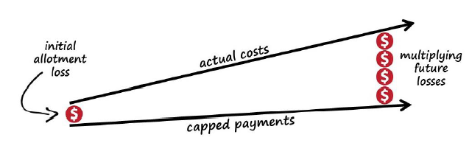
Funding Caps: Block Grant
Provide states with a set amount of federal money instead of the federal government paying a share of all a state’s actual costs
Massive cost shift to the states
Eliminates current Medicaid protections & likely lead to eligibility and service cuts and waitlists
Last version of AHCA would have allowed for some populations

Slide 52
Funding Caps: Per Capita Caps (PCCs)
Federal gov’t pays a set amount per Medicaid enrollee instead of paying for state’s actual service costs Same basic problem with starting rate and with annual growth
Unlike block grant, it accounts for changes in enrollment
Does not account for new technologies, aging population, changing health needs, etc.
Service Cuts
Lower Provider Rates
Wait Lists
Enrollment Cuts
Per Capita
Cap
Cost shift
to states
Budget
Pressure

Slide 53
Current financing v. block grants & per capita caps (in theory)*
If your state wants to. . . | Do you get more federal $?
 | Current Structure | Block Grant | Per Capita Cap
add more enrollees | ✓ | X | ✓
add more services | ✓ | X | X
cover new Rx | ✓ | X | X
increase provider reimbursement | ✓ | X | X
*This is theoretical since any proposal can alter a state’s ability to add more enrollees or other features of the Medicaid program.

Slide 54
Designing a PCC
First, a base year spending level is set
Second, an index is used to set the yearly growth rate for the base spending level

Slide 55
Per capita caps: Growth Index
AHCA, like prior proposals, use a growth index based on objective factors (such as CPI) that increase much more slowly than Medicaid spending
Last version of the AHCA proposed using a medical CPI plus 1%
  Earlier leaked House draft had a worse “chained CPI”
  But medical CPI not include LTSS in the calculation
Ultimately they make the federal funding gap grow every year
This means that states budget shortfalls in their Medicaid programs increase each year.

Slide 56

From bad to worse
Reality
PCC/Block Grant

Slide 57
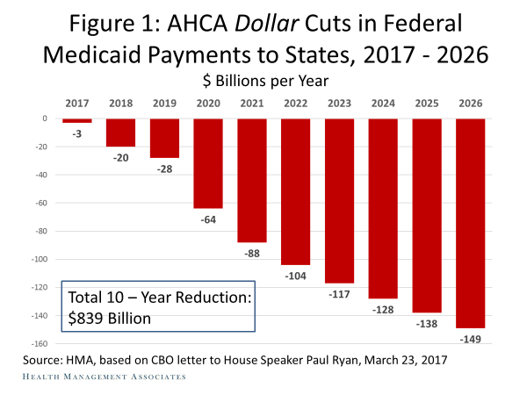
Congressional Budget Office:
Over $800 billion cut in federal Medicaid spending

Slide 58
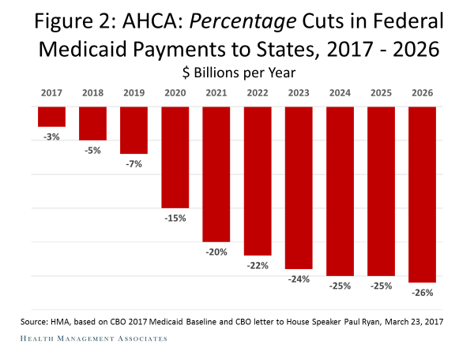
Cuts in Federal Medicaid Funds to States

Slide 59
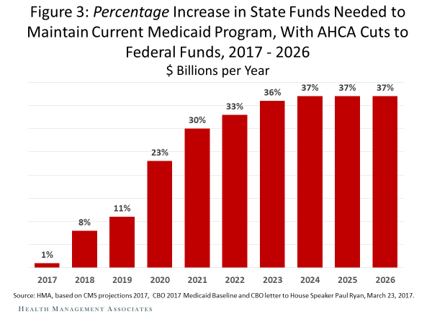
What It Will Cost for States Just to Maintain the Status Quo

Slide 60
Impact of Budget Shortfalls on People with Disabilities
As state Medicaid budget shortfalls grow, states may:
  Cut services (particularly “optional” services like waivers)
  Totally eliminate optional services (again like waivers)
  Increase waitlists for services (Many states already have thousands of people on waitlists for HCBS)
  Decrease provider rates
States that spend less per capita on Medicaid will be particularly harmed
  PCCs based on states’ 2016 spending

Slide 61
What Would Medicaid Changes Mean in CO?
Colorado stands to lose $33 billion in federal funding for Medicaid, CHIP, and financial assistance for marketplace coverage.
CO’s Medicaid spending is disproportionally on people with disabilities and seniors
  63% of Medicaid spending on people with disabilities and seniors, but only 20% of enrollees (FY ’10)
  CO is a fast growing state, with a growing senior population, all of which will make the impact of caps worse

Slide 62
What Can You Do?
Educate your representatives in Congress about the importance of Medicaid for people with disabilities, its current flexibilities, and your concerns about the impact of cuts to federal Medicaid spending through PCCs
  Go in person to local offices (especially), call or write
Educate your governor & state legislature about how PCCs would hurt your state’s budget and shift costs to your state
  There is now a lot of state specific information available
  www.protectourmedicaid.org website has state factsheets and pages for key states

Slide 63
10 Talking Points Regarding Caps
10 million people with disabilities rely on Medicaid for critical service that help them live and participate in their community (and are generally unavailable under private insurance).
The American Health Care Act (AHCA) would decimate Medicaid — it would lead to more than $800 billion in cuts over the next decade.
In response states will have no choice but to reduce services, cut optional services, restrict eligibility, and increase waiting lists.

Slide 64
10 Talking Points Regarding Caps (cont’d)
People with disabilities will be disproportionally harmed. They make up about 14% of Medicaid participants but account for 40% the cost.
The home and community based services (HCBS) on which people with disabilities rely are especially at risk because they are optional and could be completely eliminated.
There is no “acceptable” cap on Medicaid: the goal of any cap is to cut Medicaid spending.
Caps don’t give states more flexibility. They just give states less money.

Slide 65
10 Talking Points Regarding Caps (cont’d)
The caps being proposed in the AHCA have absolutely nothing to do with the Affordable Care Act (ACA). Capping Medicaid should not be part of any conversation about how to improve the ACA.
Take caps off the table and let’s have a conversation about how to improve the ACA.
The disability community opposes any bill that caps or cuts Medicaid, cuts healthcare for people with disabilities, and does not protect people with pre-existing conditions.

Slide 66
Put a Face on Medicaid
Personal stories are the most effective advocacy. Talk about why is Medicaid important to you and/or the people you serve.
  What was your/your family member’s/your client’s lives like before receiving Medicaid services?
  If you/a family member/client are on Medicaid, what are the most important services to you? What difference has that made in yours/ your family member’s/your client’s lives?
    Access to critical healthcare or therapies
    Ability to receive in-home supports, residential supports or live independently
    Ability to work or go to a day program (so your family can work)
  Are you/a family member/client on a waitlist for Medicaid services? How would getting services make a difference in your lives?

Slide 67
So What Does A Real Life in the Community Look Like?

Slide 68
Key Principles of Community Integration
Developed in May 2014 as a consensus of 28 national cross-disability organizations defining community integration.
  Employment: Opportunity to work in typical workplaces at the same wages as people without disabilities. Access to supported e-ment services as needed & choices other than segregated day services.
  Housing: Opportunity to live in own home with supports, not just congregate housing or complexes for people with disabilities. Decide where live, with whom, control over daily activities.
  Choice: Opportunity to make informed choice – requires full and accurate information including opportunities to visit integrated settings, connect with peers, & explore and address any concerns.
  Public funding: Should support these principles. Currently, public funding has institutional bias.

Slide 69
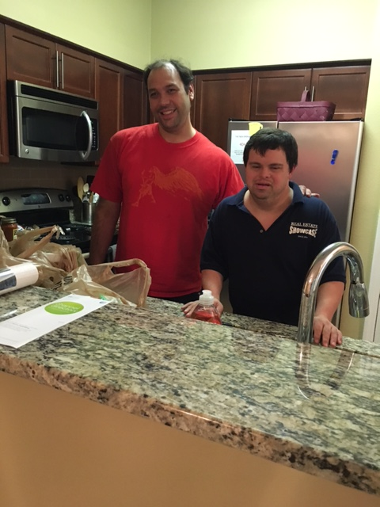

Community Living

Slide 70

A Great Job in the Community

Slide 71

Friendships

Slide 72

A Girlfriend

Slide 73
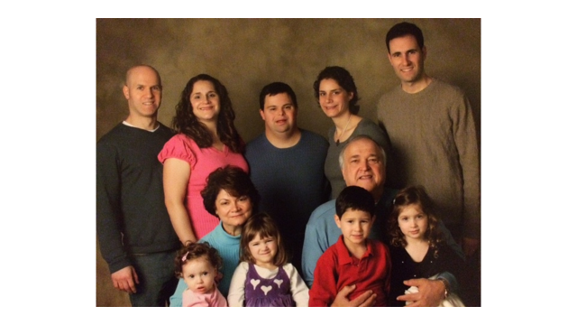
An Important Family Member

Slide 74

Self Advocacy

Slide 75
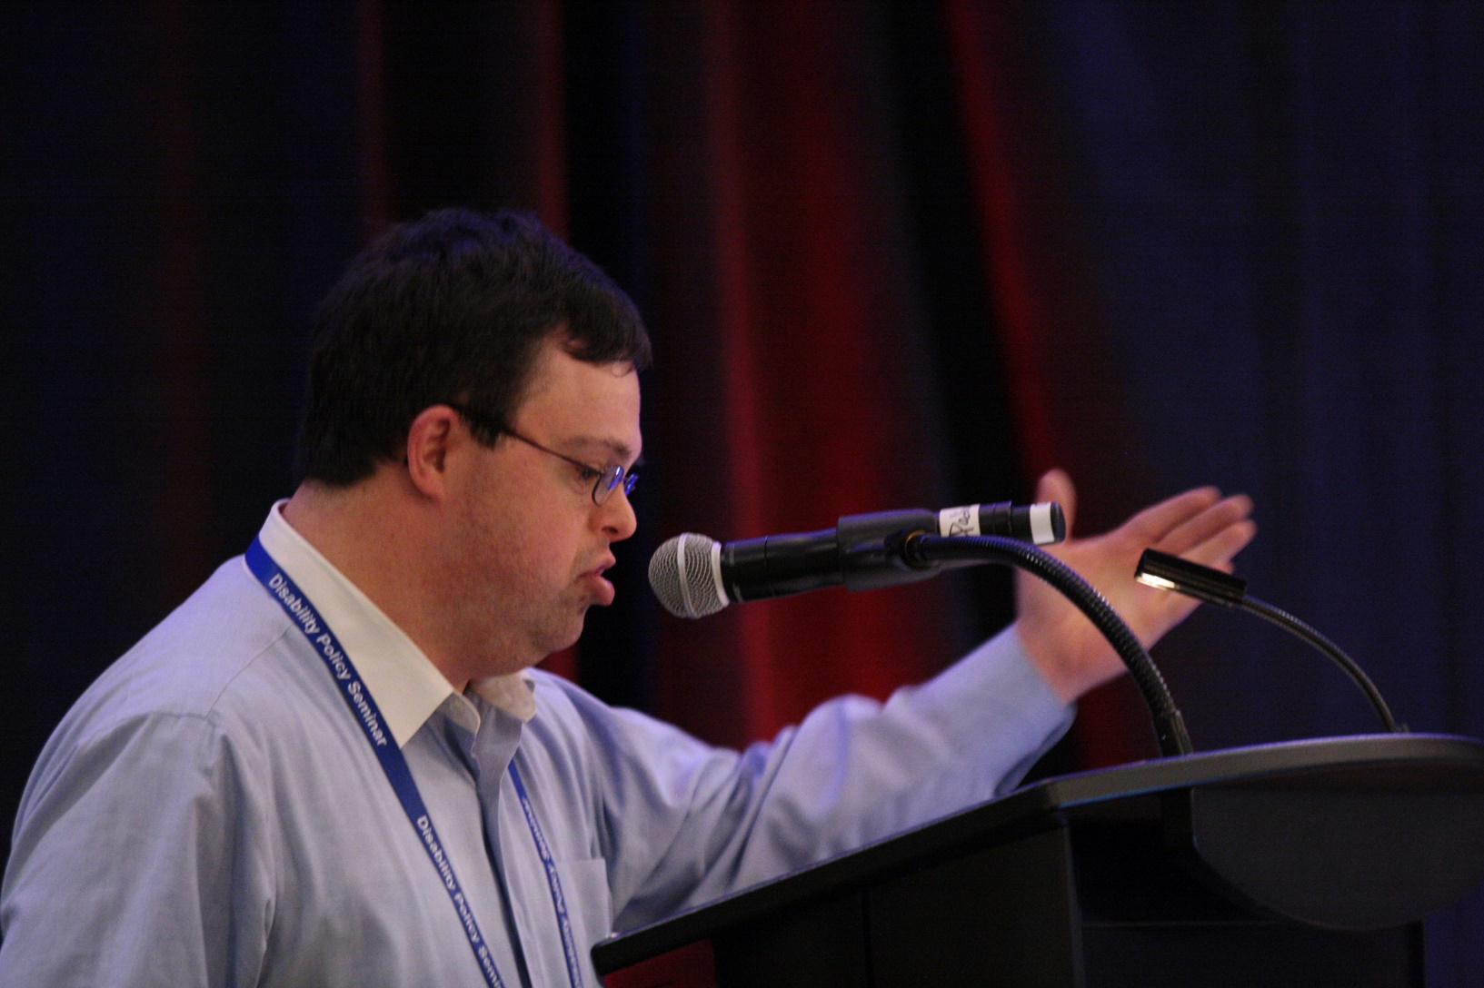
Evan Speaking About What’s Important to Him

Slide 76
Take Aways
We have made steady progress towards integration and inclusion over the last several decades, across Democratic and Republican administrations.
Recent laws and policies have added momentum and creates opportunities for state-level changes.
But there are threats on the horizon, including potential significant cuts and restructuring of Medicaid.
Advocate, advocate, advocate!!! Stakeholders must have a voice and can influence the direction of federal policies and how they are implemented at a state level.

Slide 77
Resources
HCBS Settings Rule resources:
  www.hcbsadvocacy.org (sponsored by national disability orgs)
  www.medicaid.gov/hcbs (Centers for Medicare & Medicaid Services)
Medicaid and AHCA resources
  www.protectourmedicaid.org (includes links to other resources)
  www.familiesusa.org
Olmstead resources: www.ada.gov/Olmstead (DOJ)
WIOA Resources
  https://www.dol.gov/odep/topics/wioa.htm (Department of Labor)

Slide 78
QUESTIONS?

